Slide 2
HOME CARE IN ITALY
In Italy home care is a very rare service, supported by the national health care system only for special situations, such as some ending life people

Slide 3
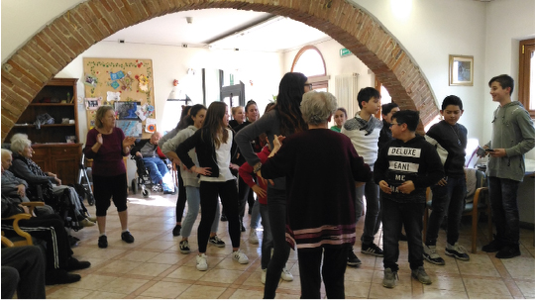
DO STUDENT HAVE A WORKING EXPERIENCE IN A HOME CARE ? HOW OFTEN? HOW IS THAT ORGANIZED?
In our socio-sanitary school, during the last three-year period, students have the opportunity to visit many organizations such as kindergarden, infantry school or nursing home . During the intership there is an internal tutor at school and a tutor responsible inside the structure, who has the task to evaluate student’s behaviour, competences and skills. Therefore he manages and controls the activities.

Slide 4
HOW IS HOME CARE ORGANIZED IN EACH COUNTRY ?
In order to enter a nursing home, old people undergo an assessment of their needs with a nurse and an assessment of their economic condition with local councils. Recently, nursing homes are becoming more ‘home-like’, looking less and less like hospitals.
The residential home is partially funded by Government and the other part by patient’s relatives in proportion with their earnings, but there are totally private institutions too

Slide 5
HOW ARE COMMUNICATIONS BETWEEN THE DIFFERENT PEOPLE INVOLVED IN THE HOME CARRIED OUT? WHO COORDINATES THE CARE? THE LIFE PROJECT, INDIVIDUALIZED PROJECT?
As you know, Italy has got a medical centred approach, so every decision is a doctor task: he coordinates the medical equipe, a healthcare team which is made up of skilled professionals including nurses, doctors, assistants and volunteers. Nurses usually become residents’ companions, playing or sitting with them and watching television together. In addition to this some volunteers provide elderly with occupational therapies, in order to spend leisure time and to save neurological skills . In conclusion, voluntary work allows older people to maintain their self-respect and has been proven to have great benefits to both their physical health and psychological well-being.

Slide 6
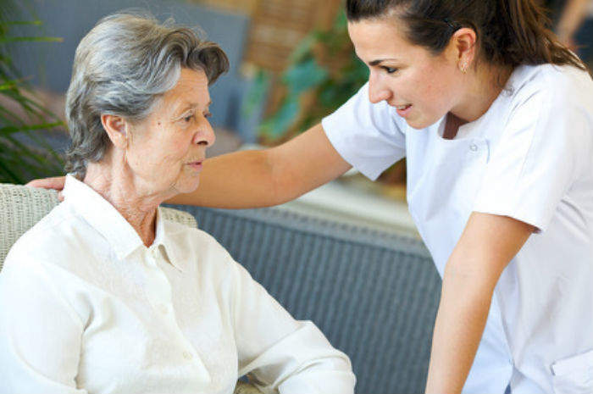
HOW MANY PATIENTS DOES THE NURSE VISIT A DAY ON AVERAGE?
It has been established that the ratio between nurse and patient is: 1 nurse for every 12 patients . Nurses turn over after 8 hours work. Shifts are the organizational tool that allows you to guarantee medical-nursing assistance.

Slide 7
WHAT PROCEDURES CAN NURSES OR HEALTH CARE AIDES PROVIDE?
While assisted living at patient’s home provides assistance in activities of daily living, they differ from home nursing housing in that they also provide a high level of medical care. A primary doctor supervises each resident’s care and needs. A nursing home may be a good choice if both medical and personal care needs have become too big to handle at home or in another facility; this may be due to a recent hospitalization, or a chronic illness which has gradually been worsening

Slide 8
KEY FEATURES OF A NURSING HOME FACILITY
Most residents of a nursing home are frail and aged, and often use canes, walkers or wheelchairs. Some are bedridden. Stays are relatively long, the majority for life. For this reason, a nursing home must be designed in a way to meet long-term human needs
Efficiency. The layout of the facility should allow for an easy visual supervision of patients by a minimal staff(in Italy home care lacks a lot of well trained nurses).
Cleanliness and sanitation. Since many residents are occasionally incontinent and the pervasive odours can give an impression of uncleanliness.
Accessibility. All spaces, both inside and outside, should be designed to accomodate the many residents who will require the assistance of canes, crutches, walkers, or wheelchairs.
Security and safety. In order to address security and safety concerns, the design of nursing homes must include the use of non-reflective and non-slip floors to avoid falls; control of exits

Slide 9
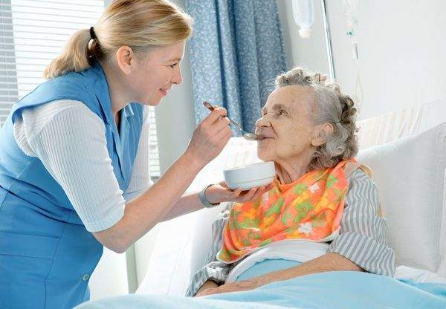
IS MEAL ASSISTANCE OR MEAL PREPARATION OFFERED IN THE HOME?
Meal assistance and assistance in preparing meals in nursing home is also provided. Naturally, before carrying out this assistance, the nurse must ensure that the patient is able to eat on his own or if he needs to be fed, he must know the patient’s alimentary habits or intollerances and whether he must follow a certain diet.

Slide 10
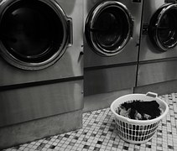
IS LAUNDRY CARE OFFERED IN THE HOME?
The laundry service can be done by patient relatives or inside the home care
In this last situation, the customer decides when together with the operator and the
work is carried out by the laundry operator .

Slide 11
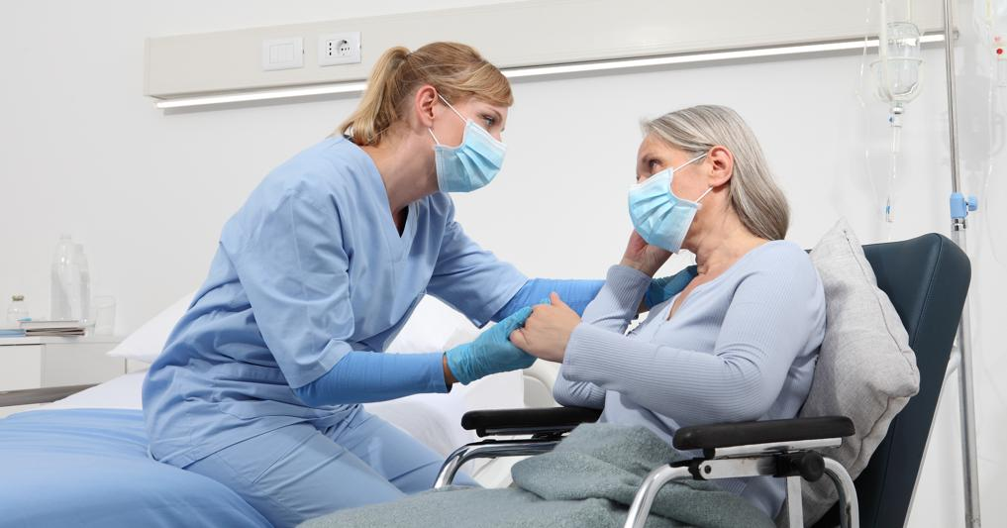
HOW IS THE END OF LIFE SUPPORTED AT HOME
The end of life for a sick person is characterized by the presence of an incurable
pathology. In this time there are definite signs and symptoms which, if recognized early,
can allow to set up the appropriate therapies to achieve a good quality of life and death
for the patient. The early detection of these symptoms also allows the family members
of the person being treated to cope with this period with greater serenity.

Slide 12
LINKS WITH THE FAMILY
There are structures that try to give relief to family caregivers, for example there
is relief hospitalization. Relief hospitalizations are activated to offer family
members a chance for relief and rest from the demanding care work they carry
out every day.

Slide 13
THANKS EVERYBODY FOR THE ATTENTION
Elena Tundo
Giulia Bossi
Anna Franco
Desiré Parissi
Giorgia Ridolfi

