Slide 1
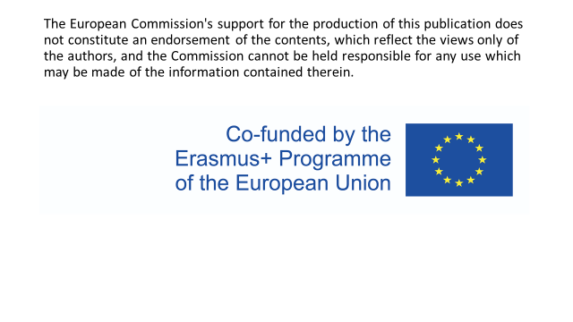

Slide 2
Rules while administering medication

Slide 3
Who is responsible for the administration of medication? [oral, infusions, i.v medication]. What kind of education do these people need?
At the hospital:
The nursing staff is empowered to prepare the pills for the care giver and authorized to give them by
◦ orally
◦ intravenous
Family has the right to prepare the pillbox according to the prescription and give to their loved one
Care giver has the right to give medication only if the medication is prepared in the pillbox
At home:
The auxiliary nurse or care assistant can only give medication if the family agrees and if it is prepared in the pillbox by the nurse

Slide 4
How many people is necessary for the preparation and the administration of medication? [in some countries a witness is required]
In France, 2 people: a nurse and a pharmacist

Slide 5
How do nurses record the administration of medication? [Only with tick? Signature? Stamp? Is witness needed?]
The act of administration is most often performed by the nurse from a medical prescription. It is the professional who administers who must control the intake and keep track of it, so record the evidence in the patient's file.
The nurse writes on the transmission book the administered drugs, the transmission book can be computerized

Slide 6
Can a night shift nurse prepare medication and then a day shift nurse administers it to the patients? Or is it necessary that these two duties are done by the same nurse?
Yes, in France a night nurse can prepare medication for the day nurse for the next day.

Slide 7
Can nurses administer patient’s own medication in hospital?
Nurses administer medications only with a doctor's prescription

Slide 8
If the nurse cuts a tablet and administers only a half, can she return the other half to the original container?
Cutting or crushing a medicine alters the pharmaceutical form and therefore risks strongly modifying the action of the active ingredient. It is therefore forbidden to put an opened tablet back into the container.

Slide 9
Can nurses prescribe any kind of medication?
Since 31 March 2012, nurses are authorised to prescribe certain medical devices, the list of which is limited
The list of medical devices that nurses are allowed to prescribe subject to the following three conditions being met:
1. The nurse acts for the duration of a medical prescription for a series of nursing procedures.
2. The nurse acts within the scope of his competence.
3. There is no contrary indication from the doctor.

Slide 10
Articles for bandages:
o sterile adhesive dressings with integrated pad ;
o sterile (cotton wool) adhesive-edged compresses; o sterile non-adhesive cotton wool compresses
o sterile non-adherent cotton wool pads
o non-adherent absorbent sterile dressings and pads for productive wounds;
o sterile non-woven compresses;
o sterile hydrophilic gauze pads;
o non-sterile hydrophilic gauze;
o Non-sterile hydrophilic gauze and non-woven non sterile compresses;
o Non-sterile cotton wool;
o Surgical cellulose wadding;
o Elastic and non-elastic plasters;
o Tubular nets and jerseys;
o cotton crepe strips with or without elastomer;
o woven or knitted stretch tapes
o woolen crepe tapes;
o Sterile semi-permeable adhesive films;
o wound kits;

Slide 11
- sick bed hoops ;
- medical devices for the treatment of incontinence and for the urogenital system:
penis case, joint and connector ;
pelvic pan and urinal;
common medical devices and accessories for urinary, faecal and ostomy incontinence: pouches, connector, filter, pad, supports with or without gum ring, belt, clamp, peristomal protection paste, absorbent pad, faecal plug, urine and faeces collector;
Colostomy irrigation devices;
colonic irrigation kit;
bladder catheters for self-catheterisation and heterocatheterisation;
- medical devices for home infusion :
home infusion devices and accessories: sterile non-reusable infusion set, infusion basket, precision infusion set, single-use accessories for filling the infusion set or portable infusion set, single-use accessories for placing the infusion on the patient's arm if there is no implantable catheter;
accessories necessary for the use of an implantable catheter chamber or a tunnelled central catheter: needles necessary for the use of the implantable catheter chamber, needle, transparent adhesive, extension, three-way tap;
Sterile, non-reusable accessories for heparin: syringes or adapted needles, extension, 3-way tap;
wheeled serum stands and gallows.

Slide 12
-If the nurse fulfils the three conditions set out in the first case of prescription and has also previously informed the patient's designated doctor, he or she may also prescribe the following medical devices:
pressure sore prevention mattress or mattress topper made of foam with waffle cut-out;
pressure sore prevention cushion :
Static air cushions …
Bandages :
hydrocolloids ;
hydrocellular ;
alginates …
nasogastric or naso-enteric tube for home enteral nutrition;
as part of a replacement, elastic orthoses for limb restraint:
in the context of an identical renewal, accessories for blood glucose meters
Note: Nurses cannot prescribe sets that include one (or more) medical devices not listed above.

Slide 13
What are the rules while administering narcotics and storage of narcotics? [ Differences in administering narcotics and other medication, where are narcotics stored, who can administer them, how is this procedure recorded]
The rules to be respected for the administration of narcotics are :
prescription in words on a secure prescription.
number of therapeutic units per dose.
dosage of specialities.
prescription limited to 28 days, and split dispensing for certain drugs (7, 14 days).
number of doses.
They are stored in a locked safe
Pharmacists can only dispense narcotics if the prescription is presented within three days.
There is no longer an obligation to keep a manual prescription book for these medicines if the recording of their dispensing is ensured by the computerised prescription book.

Slide 14
What are common mistakes while administering medication and why do these slip-ups happen?
Reconstitution errors: specialty errors, dilution or labelling errors.
Administration errors (most common): syringe error, volume error, flow rate error, route of administration error, patient error.

