Slide 2
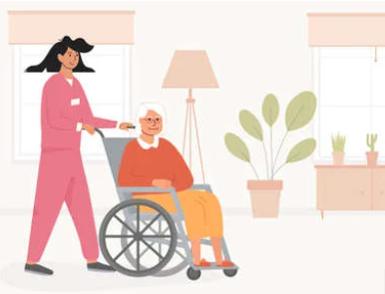
Comparison of home care
in France, Czech Republic, Italy, Belgium
Notes:
2

Slide 3
1.Do student have a working experience in a home care ? how often? how is that organized?
In France, in order to obtain the vocational baccalaureate, WE have to spend 10 weeks internship at home, i.e. 2 periods of 5 weeks.

Slide 4
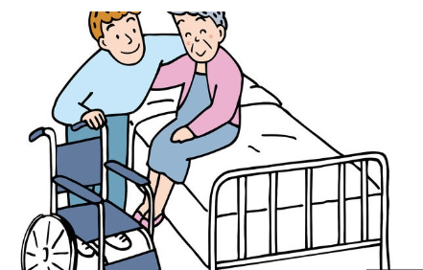
2.how is home care organized in each country ?

Slide 5
Describe the major aids or services that support home care
FOR ELDERLY AND/OR DEPENDENT PERSONS
Personalized autonomy allowance. This is granted, under conditions, by the local councils to people living at home.
Social assistance is offered by local councils or the pension funds.
FOR PEOPLE WITH DISABILITIES
The disability compensation benefit . This benefit covers human and material assistance (home and vehicle improvements). It is paid by local council, without incomes conditions.
The allowance for the education of disabled children for children and young people under the age of 20 is a family benefit intended to support people who are responsible for a disabled child.

Slide 6
Is home care available to all patients who need it?
Home care services are offered to vulnerable groups : people aged 60 and over who are ill or losing their independence, and people under 60 who are disabled or have a chronic illness

Slide 7
What are the structures that manage home care (public service, association under the law of 1901, profit-making associations, private companies)?

Slide 8
The social authorities :
The National Old Age Insurance Fund :
Set up and finance schemes for retired people who are not in a situation of loss of autonomy:
﻿﻿the mechanism for assessing the needs of retired people;
﻿﻿the personalized action plan; help for household, carrying meals, shopping, hygiene...
﻿﻿Define the number of hours of support granted.
The local schemes :
Coordinate the actions carried out in favour of the elderly.
They can deliver:
﻿﻿personalized autonomy allowance;
disability compensation allowance.
They can ﻿finance:
﻿﻿home help; social assistance for people with low income.
They ﻿﻿Coordinate the actions of the various actors involved in home help.
Define the number of support hours granted,

Slide 9
THE PARTNERS :
Municipal Social Action Centers : Investigate applications for APA, MDPH benefits, social assistance, home help benefits.
﻿﻿Set up home help services, SIAD, foyers-restaurants.
Local Solidarity Houses : Social workers receive users, assess their needs and direct them to the appropriate service.
Local Centers of information and Coordination : Welcoming, informing, assessing needs and directing people over 60 to the service best suited to their needs.
Local houses:
People with Disabilities : Welcome, inform, assess needs and direct people with disabilities to the service adapted to their needs.

Slide 10
3.How are communications between the different people involved in the home carried out? Who coordinates the care? the life project, individualized project?
At home, transmissions are generally made in writing in a liaison book that remains in the home of each person being helped. It is filled and signed after each intervention.
Home helpers and Care assistants coordinate the care in collabonation with the doctor. The project of life is established with the person taken in charge, his/ her legal representatiue if need be and the persons intervening in his/ her care.
The individualized project is coordinated by the sector manager.

Slide 11
4.how many patients does the nurse visit a day on average
Nurses visit an average of 20 patients per day.

Slide 12
a- How is the intervention time calculated?
For a nurse care:
The time spent with the patient depends on the person's needs and budget, but it cannot be less than 30 minutes and not more than 2 hours;

Slide 13
b- Is the time spent travelling counted as part of the employee's working time?
Yes, it is considered as work

Slide 14
c- Does the employee use his/her own car or a company car?
Housekeepers and home helpers must have their own car, whereas nurses and care assistants can use a company car. It sometimes depends on the company they work for.

Slide 15
5.What procedures can nurses or health care aSSISTANTS provide?

Slide 16
a. What are the differences between the duties of the nurse and the home health aSSISTANT?
The nurses focus more on technical care (basic care and care on medical prescription) They are also responsible for the acts of the caregiver while the caregiver only makes the basic care, hygiene and conform. The diploma as well as the studies are not the same, the nurse goes to school three years after the baccalaureate to come out with the diploma of caregiver and nurse whereas the caregiver goes to school two years after the baccalaureate to get only the diploma of caregiver.

Slide 17
b. Specify the roles and training of social workers, home health assistants
The life assistant intervenes with frail people. Depending on the person he/she is working with, he/she prepares balanced meals in the context of the person in the acts of daily life and in particular helps with toilets. You need a state diploma in educational ans social at the NVQ level.
The housekeeper is dedicated to the maintenance of the house (laundry, vacuuming, dusting, ironing, sewing…) it can also do household shoppinG (pharmaciy, bakery, grocery…). This job is available without special training.

Slide 18
c. What degrees or qualifications are required to work in home care services?
One of the most required diploma is that of family life assistant, which can be obtained with a professionalization contract. There is no care taken.
To carry out toilets and care, they are exactly the same diplomas as for the medico-social structures (care assistants and nurses)

Slide 19
d. What is the average salary for a nurse, and a home health aide?
A general care nurse at the beginning of his/her career will receive € 2 026 net per month.
A care assistant at the beginning of his/her career will receive €1 760 net per month.
A home care assistant will receive € 1300 net per month.

Slide 20
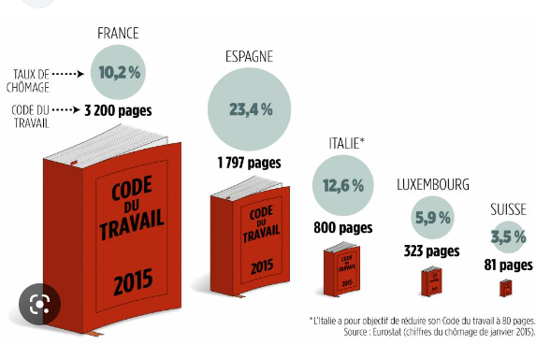
e. What is the average working week for the different categories of staff working in home care?
35 working hours is the law in France.

Slide 21
6.Is meal assistance or meal preparation offered in the home? If so, how long does it take to meet the demand? Who does it?
Yes, meal assistance or meal preparation is offered at home.
Assistance with meals or meal preparation can be covered by financial aid if the elderly person has difficulty carrying out daily tasks, and home helpers are responsible for providing this assistance.

Slide 22
7.Is laundry care offered in the home? If yes, how much time is required to meet the demand? Who does it?
Yes, laundry care is included at home. Life auxiliary does it
It is often necessary to participate in the folding or ironing of clean clothes. It’s included in the service if requested by the family

Slide 23
a- Present the structures offering respite to family carers:
EHPAD (Etablissement d'Hébergements pour Personnes Agées Dépendantes)
MAPAD (Home for the Dependent Elderly)
Other care structures and institutions may offer day care in a dedicated space, in addition to their main accommodation activity

Slide 24
b- What are the links between the family and the staff working at home?
The link with the family is important, there must be confidence on both sides, as it facilitates the intervention between the user and the helper
Be attentive to the family's request for the well-being of the user

Slide 25
c- Is there any training for family caregivers?
The French Association of Carers offers a training programme throughout France. Its objective is to enable carers to question and analyse the situations they experience in their relationship with a disabled or incapacitated relative in order to find appropriate solutions.

