Slide 1
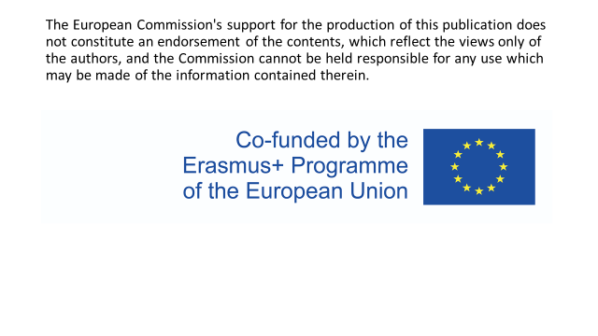

Slide 2
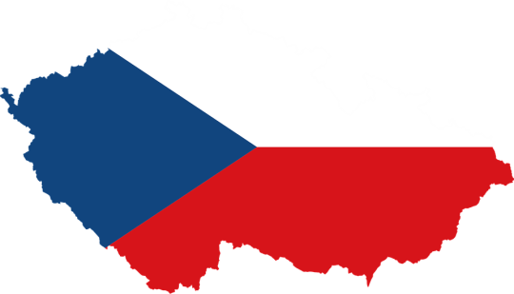
CZECH REPUBLIC
Šárka Suchardová and Daniela Štajerová

Slide 3
content
NATIONAL SYMBOLS
GEOGRAPHY
HISTORY
CULTURAL AND PUBLIC HOLIDAYS
FOOD
CZECH FAMOUS PERSONALITIES
INTERNATIONAL IMPORTANT EVENTS
TRADITIONAL CZECH BRANDS
PRAGUE

Slide 4
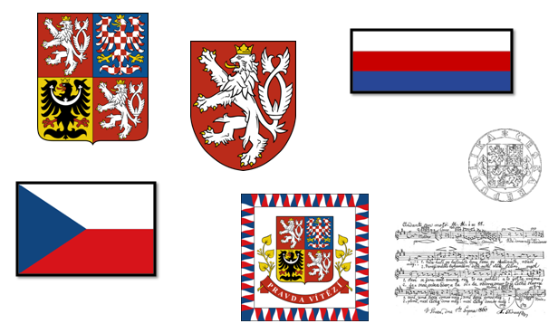
NATIONAL SYMBOLS

Slide 5
GEOGRAPHY

Slide 6
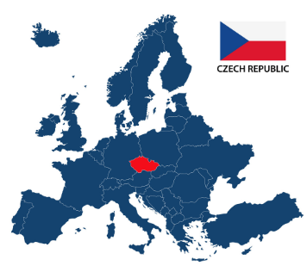
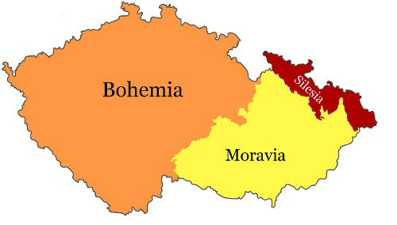
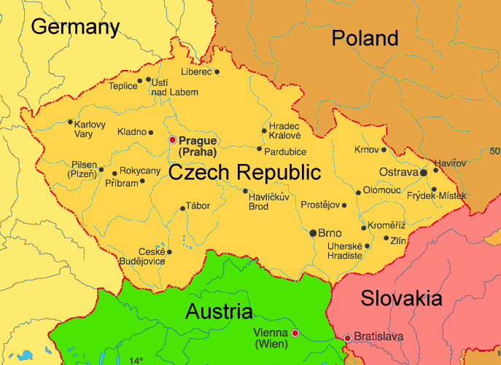

Slide 7
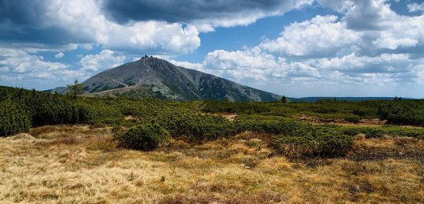
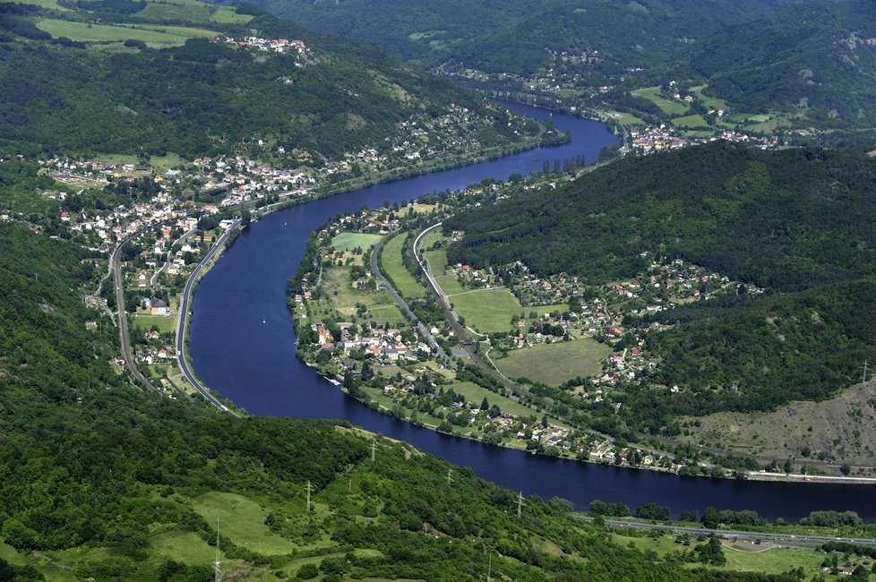
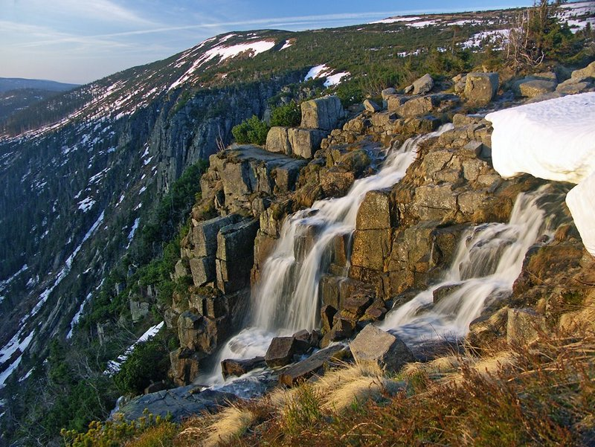
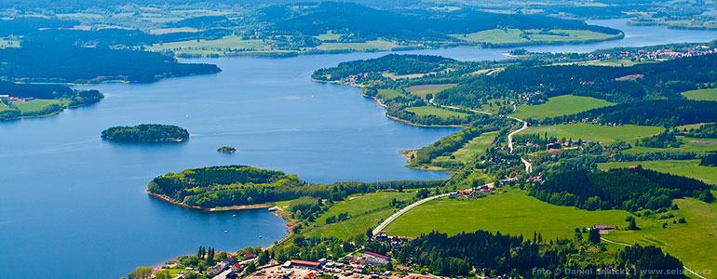

Slide 8
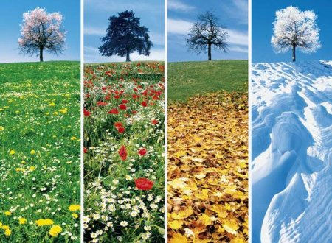
WEATHER

Slide 9
HISTORY OF CZECH REPUBLIC

Slide 10
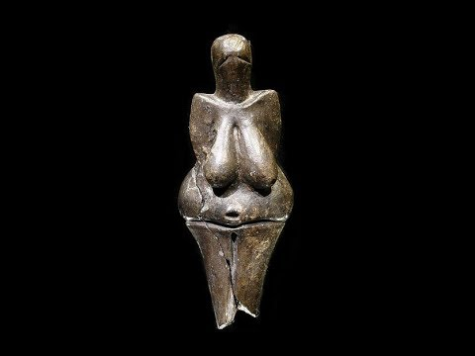
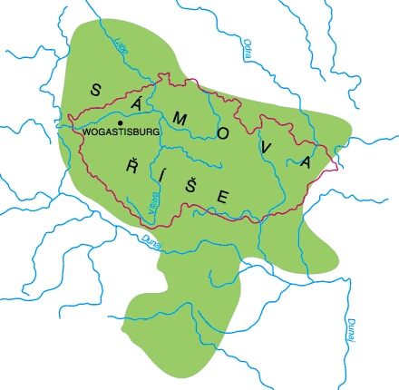
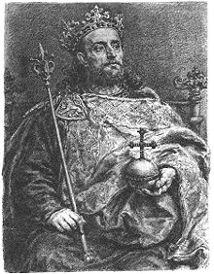
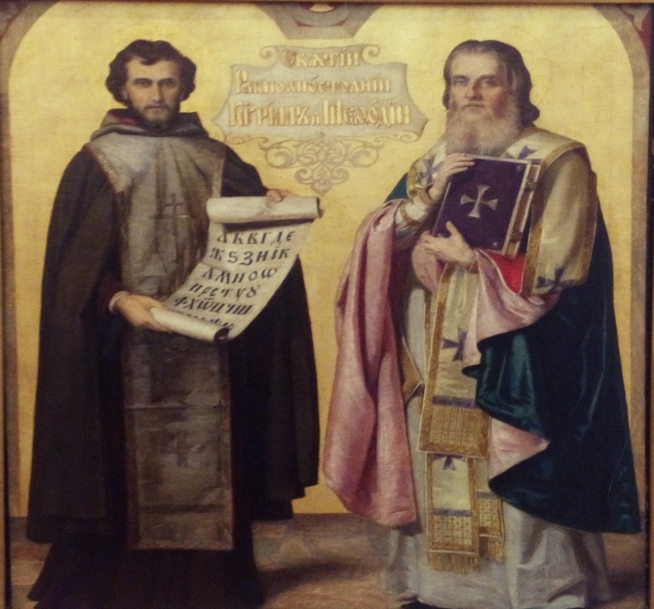

Slide 11
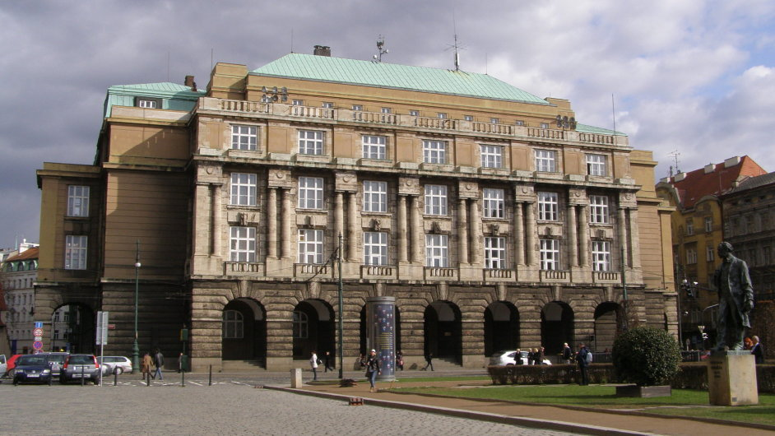
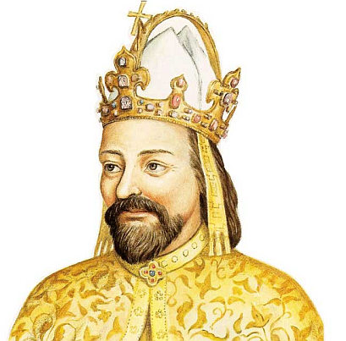
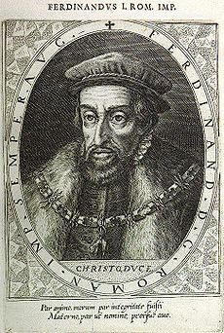
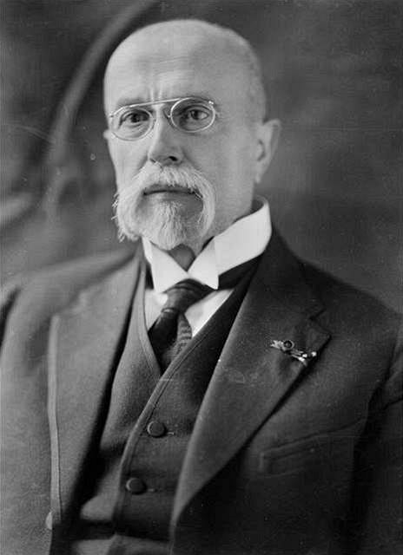

Slide 12
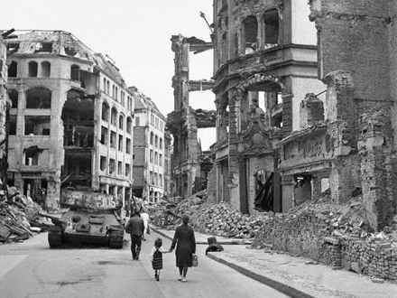
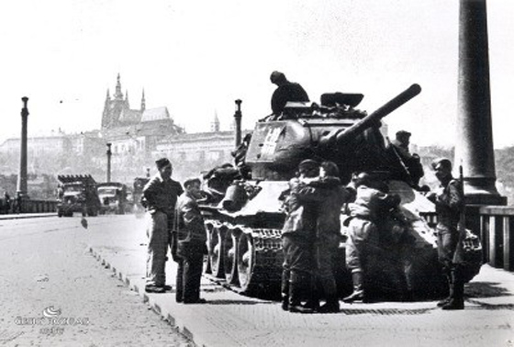
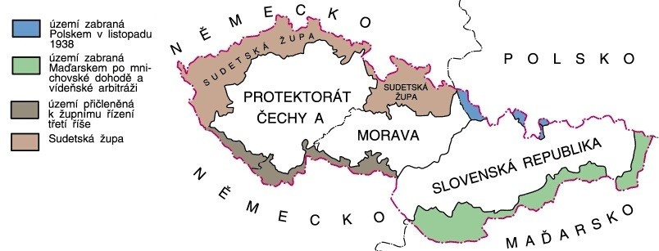

Slide 13
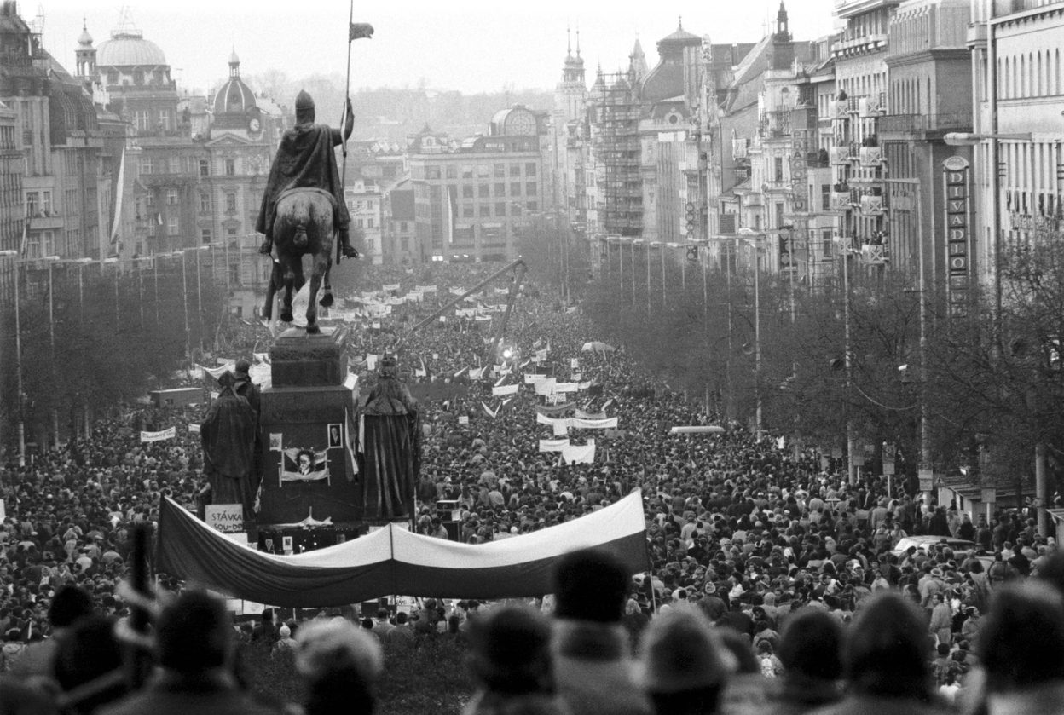
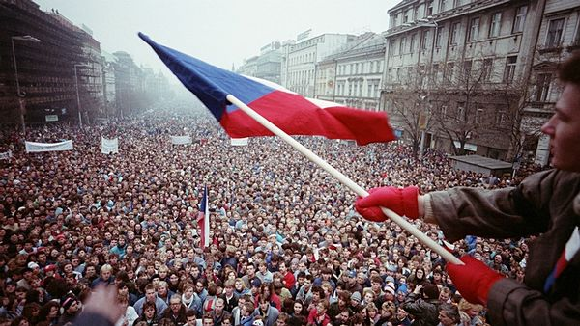
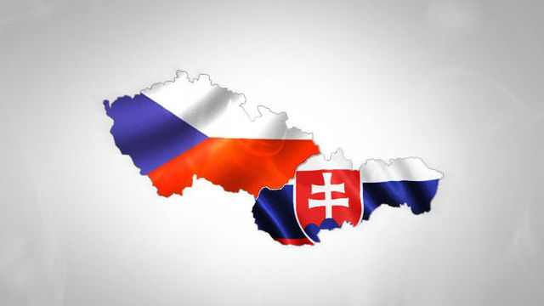

Slide 14
Cultural and public holidays

Slide 15
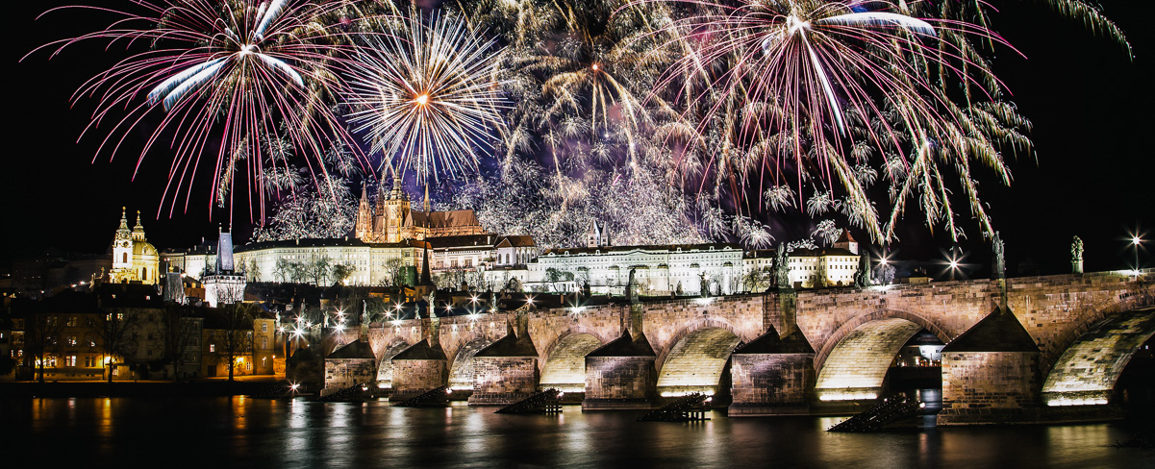
New year's day restoration day of the independent czech state

Slide 16
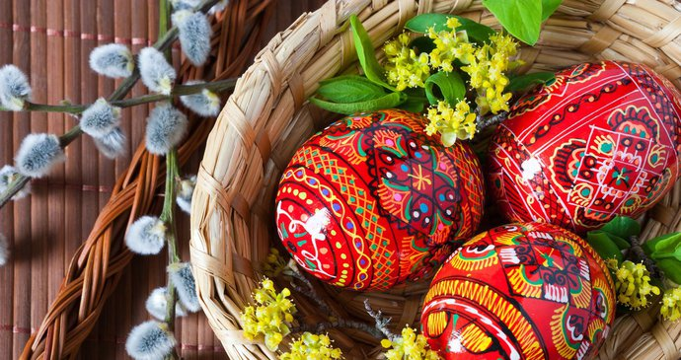
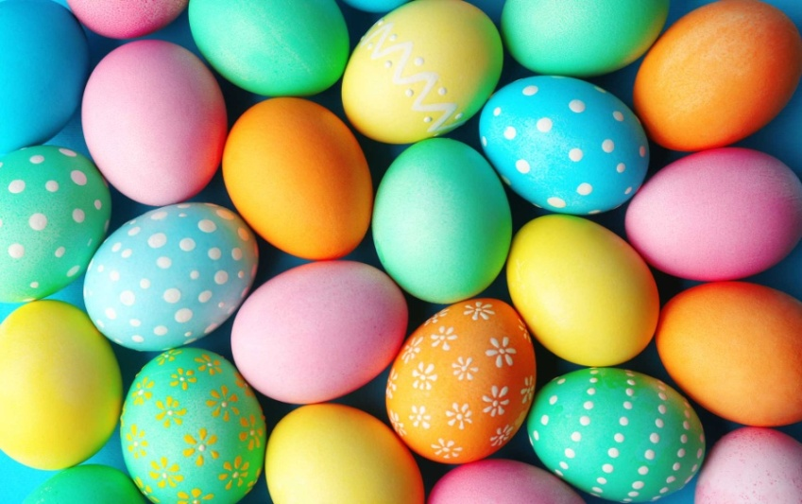
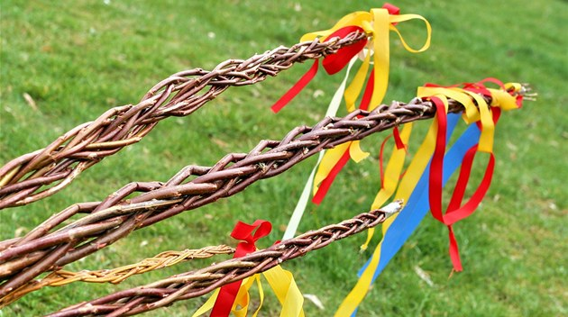
EASTER

Slide 17
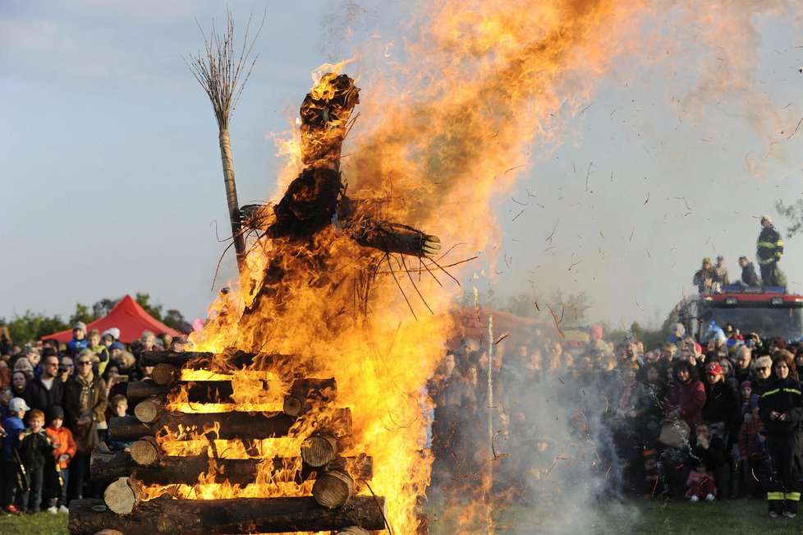
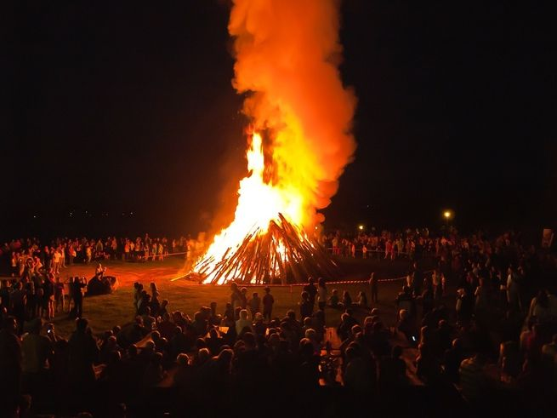
WITCH BURNING OR NIGHT OF WITCHES

Slide 18
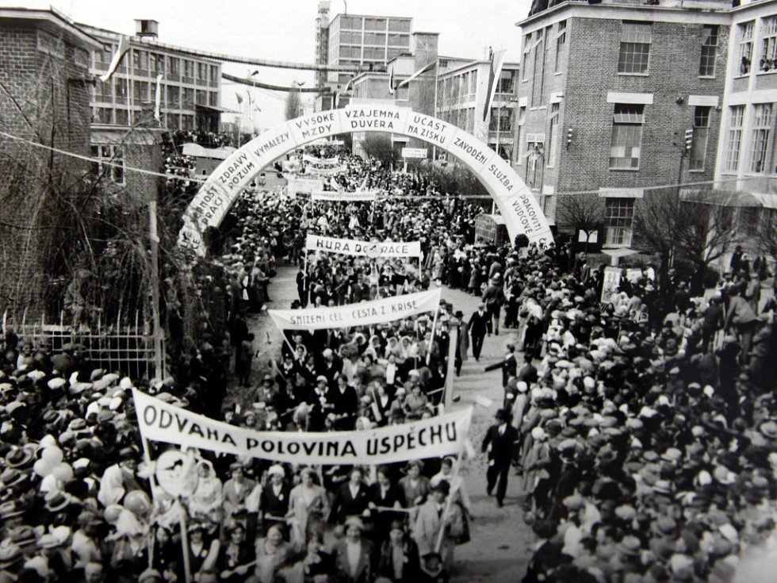
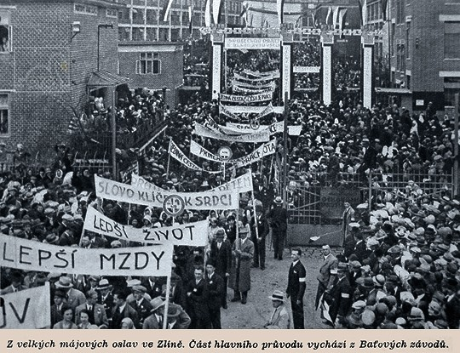
May day

Slide 19
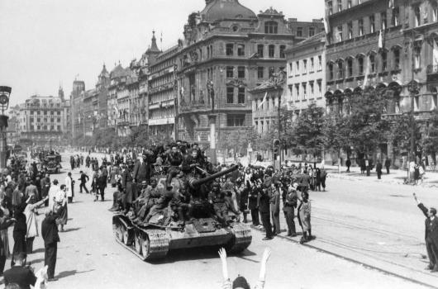
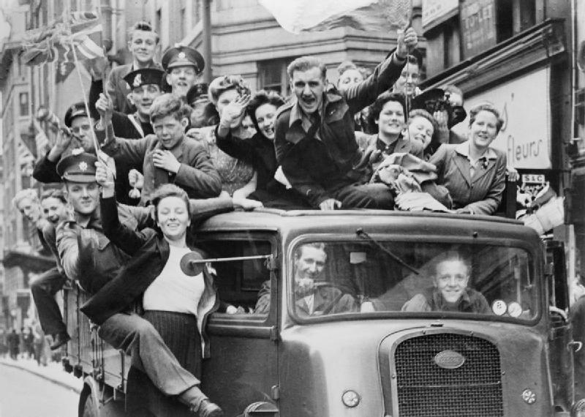
Liberation day

Slide 20
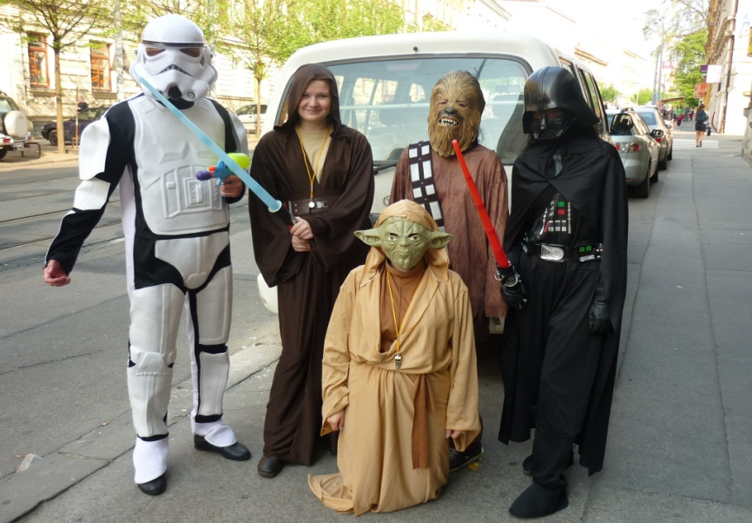
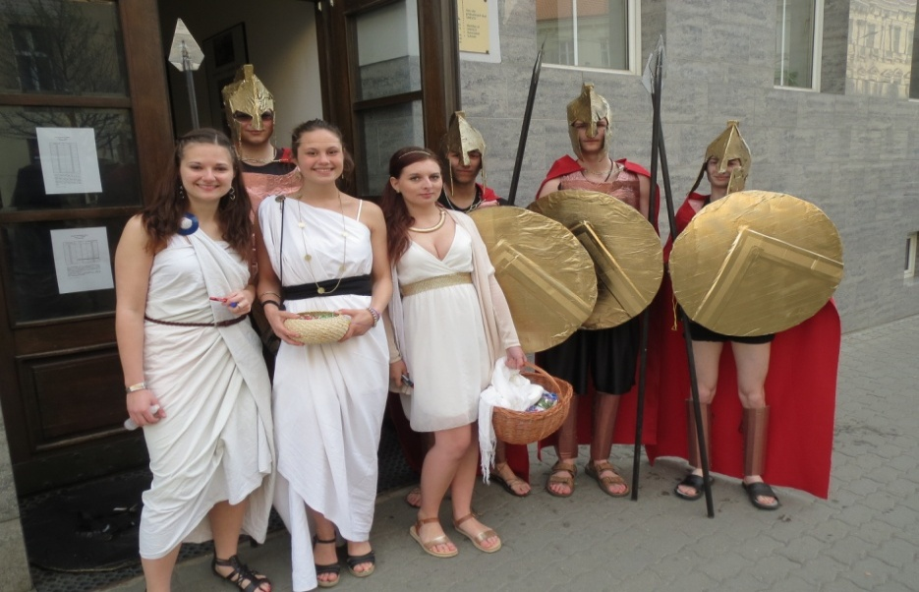
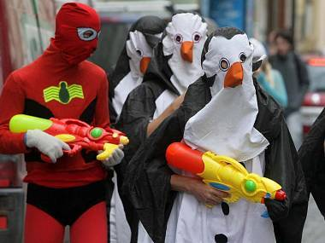
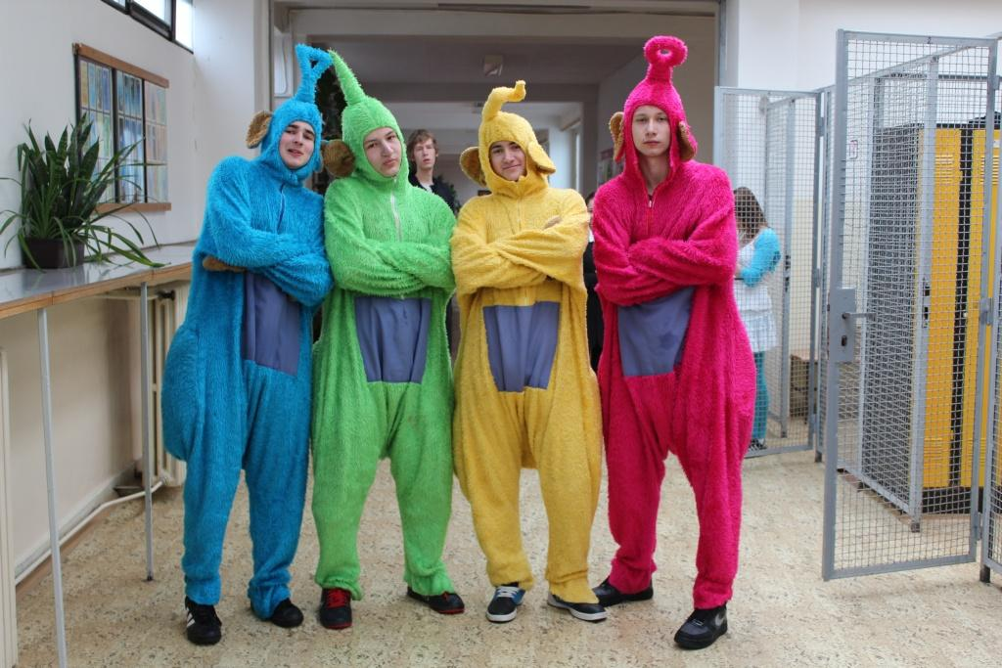
Last ringing

Slide 21
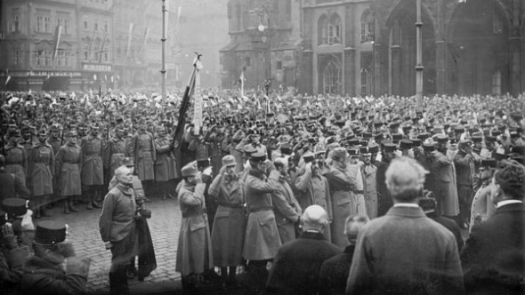
Czechoslovakia independence

Slide 22
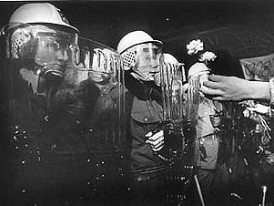
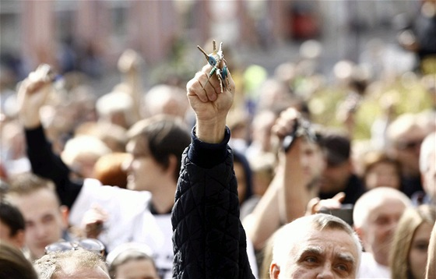
Day of struggle for freedom and democracy

Slide 23
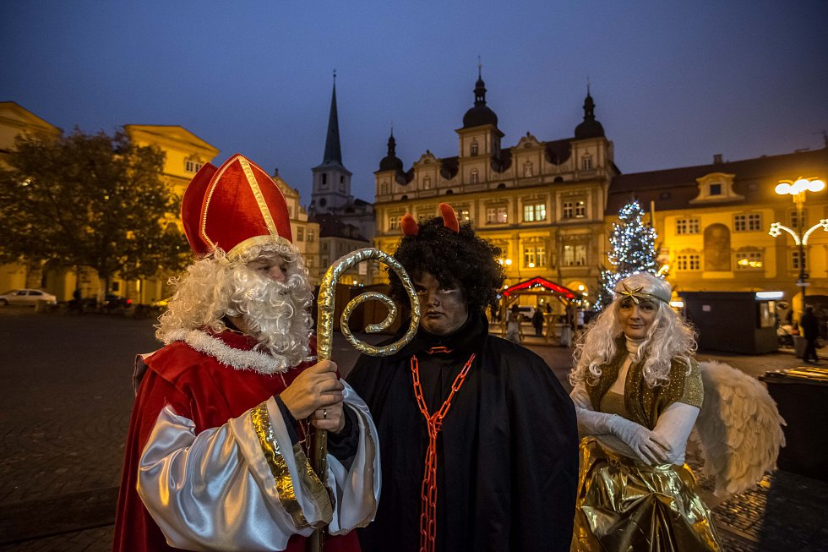
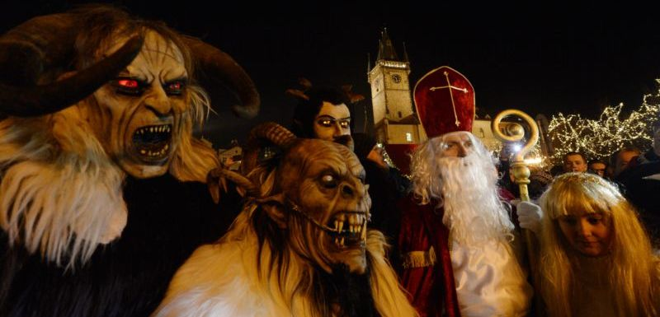
Feast of st. mikuláš

Slide 24
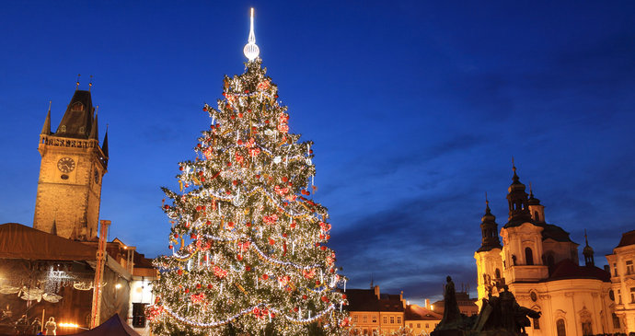
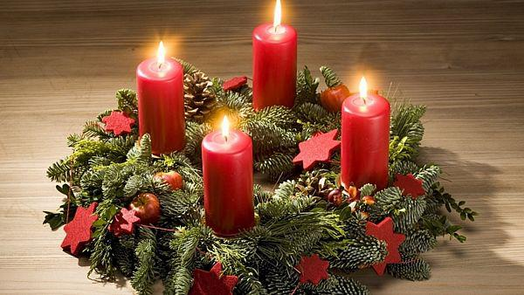
christmas

Slide 25
FOOD

Slide 26
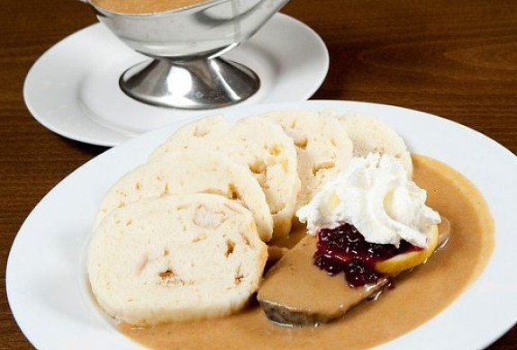
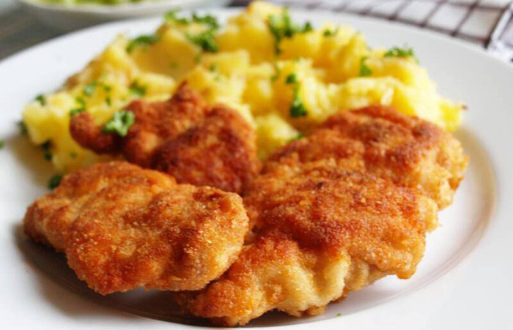
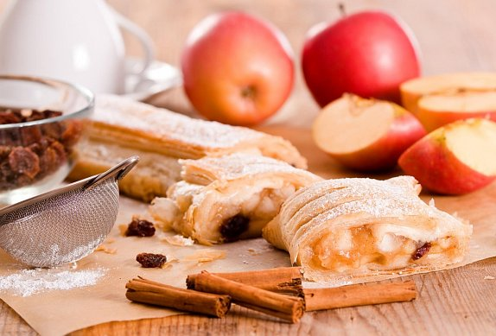
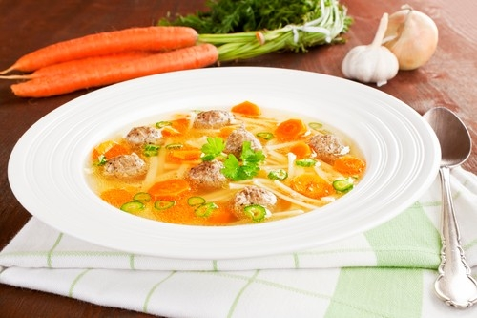

Slide 29
CZECH FAMOUS PERSONALITIES

Slide 30
WRITERS
Karel Čapek
Jan Ámos Komenský

Slide 31
MUSICIANS
Karel Gott
Antonín Dvořák
Emma Destinová
Bedřich Smetana

Slide 32
painter

Slide 33
scientist

Slide 34
SPORT
Petr Čech
Petra Kvitová
Jaromír Jágr
Martina Sáblíková

Slide 35
Věra Čáslavská
Emil Zátopek
Barbora Špotáková

Slide 36
INTERNATIONAL IMPORTANT EVENTS

Slide 38
Traditional czech brands

Slide 40
PRAGUE

Slide 43
THANK YOU FOR ATTENTION

