Slide 1
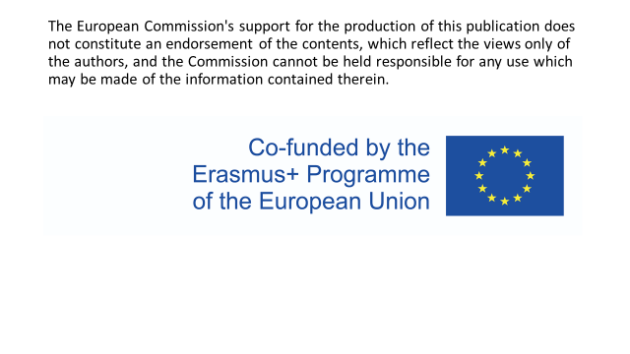

Slide 2
LANGUAGE COMPETENCE OF STUDENT NURSES

Slide 3
WHICH FOREING LANGUAGE CAN WE STUDY?
The most common is English
We start to learn English in third grade on primary school a (some students has learnt it since kindergarden)
On secondary school we can choose our second language
You can choose from: German, Russian, Spanish or French
Vocational school is a bit different, our school offers different language than English only for medical Lyceum and it is German language
Nurses like us study English and in the first year Latin

Slide 4
ENGLISH ON SECONDARY MEDICAL SCHOOL
As we said before English is beeing taught since first year
The standart is four lessons per week
We finish our studies with maturita exam, which tests our knowledge of level B1 English
You can choose between English or Math but majority of students goes for the English.
This year we have option to take the FCE test where you get level B2 certificate
You have to pay to take part in it
You can continue learning English on university or higher vocational school

Slide 5
HOW AVERAGE LESSON LOOKS LIKE?
We do different kinds of exercises to practise on maturita exam
Reading, listening, writing and conversation
Also we have to make presentation about different topic related to English (once or twice a year)
Every teacher does different exercises and practises but all students are going to be prepared for their maturita exam
It also depends how you study at home not just on your teacher

Slide 6
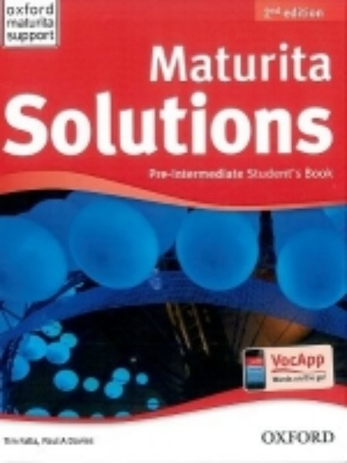
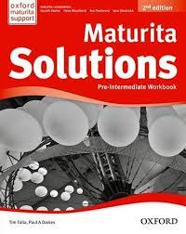
TEXT BOOK AND WORKBOOK
Also We can order Bridge magazines if the majority of students agree

Slide 7
HOW MATURITA EXAM WORKS?
It has three parts
Essey
Didactic test
Oral exam

Slide 8
FIRST PART – ESSEY
Here is an example of assigmnent
You can choose topic of your essey from it
The topics vary in stylistic types
The range of words is from 200 to 230 (it depends on the assi- ment)
The time limit is 60 minutes
Students with disablities have more time

Slide 9
SECOND PART – DIDACTIC TEST
It is a test consisted from 2 parts:
Listening
Writing and language competence
You have 40 minutes for listening part and 70 minutes for the writing and language competence
To pass the test you need 42 points (that is the minimum)

Slide 18
THIRD PART – ORAL EXAM
It consists from 3 parts
Examiner is going to ask you some questions and you have to answer it. (2,5 minute)
Picture description (4 minutes) TASK 1: choose a picture and describe it TASK 2: compare two picture TASK 3: talk about how you prepared for maturita exam
Talk about a selected topic (6 minutes)

Slide 19
v

Slide 20
MEDICAL TOPICS IN FOREING LANGUAGE
In Latin our students learn basics like parts of a body or medical terms.
In English we learn body parts, the most common illneses, names of hospital wards etc.
Also some of our presentations and esseys are about nursing or medical topics
But the most enriching is erasmus like this one.

Slide 21
THANK YOU
KAROLÍNA HURDÁLKOVÁ, VERONIKA BAJANOVÁ, KRISTÝNA BRUMLICHOVÁ

