Slide 2
FIXATION PHYSICAL RESTRAINT

Slide 3
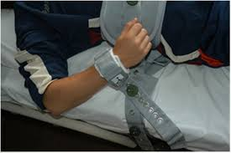
In general:
The use of physical restraint is not allowed

Slide 4
PHYSICAL RESTRAINT
An exception for physical restraint use can be made
provided that legal considerations are respected and there is strict compliance with the existing regulations.
In Belgium, only nurses and physicians are allowed to apply physical restraints in the context of providing healthcare.

Slide 5
PHYSICAL RESTRAINT
The guideline integrates the patient’s rights (e.g., informed consent for persons who are competent to make decisions and proxy consent for persons who are incapable of giving informed permission)
The guideline emphasizes the need for the utmost care (i.e., the application of the carefulness principle)
When the use of physical restraints is considered, requested or already present.

Slide 6
PHYSICAL RESTRAINT
healthcare providers clearly report in the patient record all steps of the decision-making process to ensure high standards of care.
Important organizing a meeting with all involved persons
discussing the underlying behaviour or circumstances resulting in the use of physical restraint
comprehensively reporting, using relevant documentation, the decision-making, application and evaluation processes. All healthcare providers involved in the decision must be informed.

Slide 7
PHYSICAL RESTRAINT
Based on legal principles, the guideline requires that physical restraints be used only as a last resort

Slide 8
LEGALLY PROTECTIVE STATUTES

Slide 9
PROTECTION AND ADMINISTRATION FOR ADULTS
When a person is no longer able to make decisions for himself or to manage his property, he is entitled to extrajudicial or judicial protection.

Slide 10
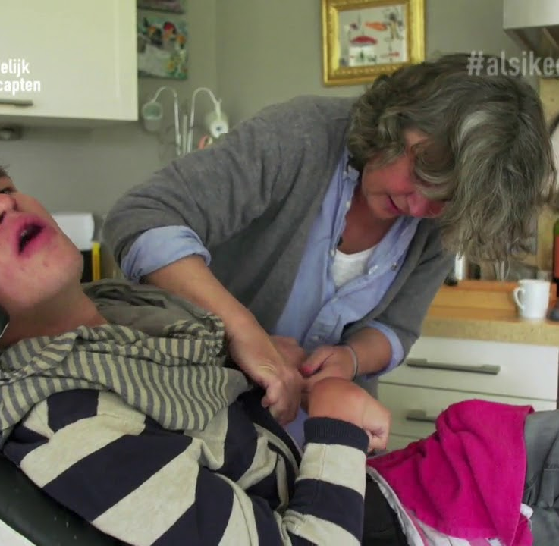
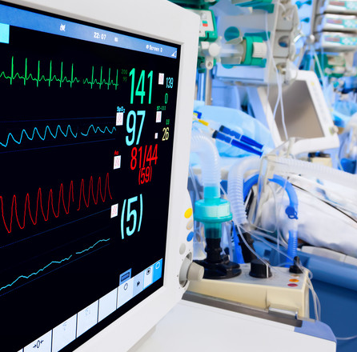
FOR WHO?
Adults who because of their state of health are unable to exercise their personal rights or manage their property themselves.
people with dementia
Coma patients
people with an intellectual disability
psychiatric patients. Who waste their income on useless expenses (for example, due to a mental disorder).

Slide 11
REQUEST
By:
the person to be protected himself
his family
another interested party (such as a neighbour, a carer or a social worker)
by the public prosecutor.

Slide 12
WHY?
the management of goods and the management of personal rights.
You can obtain extrajudicial protection by giving a power of attorney to someone you trust to perform certain acts on your behalf.
The mandate must be given while you are still able to do everything yourself.
You decide when the power of attorney takes effect (for example, when you become incapacitated) and you can also stop it at any time.

Slide 13
HOW?
The intervention of the judge is necessary
The justice of the peace will appoint one (or more) administrators who will assist or represent the protected person.
The justice of the peace provides protection tailored to the person. In doing so, he will take into account what the protected person is still able to do.
He determines whether the protection is only necessary for the person, the goods or both.
The court also determines whether only assistance or representation is required from the protected person.

Slide 14
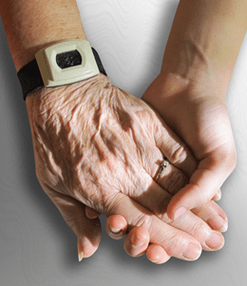
ASSISTANCE ≠ REPRESENTATION
Assistance: the protected person acts himself, but not independently - the administrator must agree.
Representation: the administrator acts in the place of the protected person. The administrator must involve and inform the protected person in this.

