Slide 1
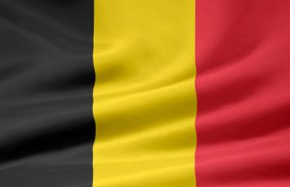
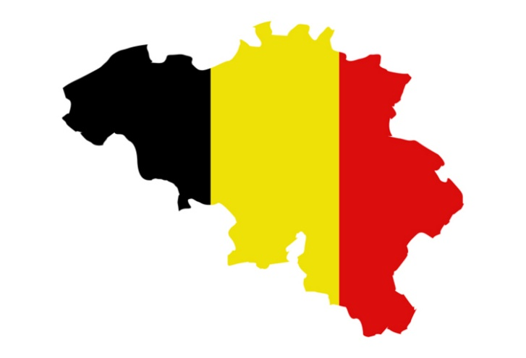
Belgium

Slide 2
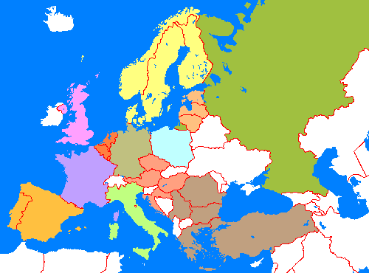
Where is Belgium

Slide 3
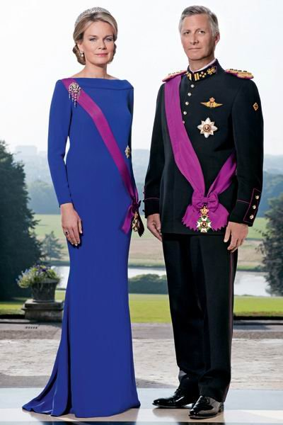
Belgium
Constitutional monarchy
Independent country since 1830 after Belgian revolution, where we separated from the United Netherlands.
King Filip and Queen Mathilde
Capital: Brussels

Slide 4
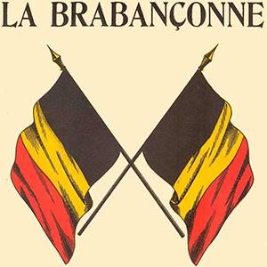
The national anthem:
La Brabançonne
https://youtu.be/cUplg16ovjY

Slide 5
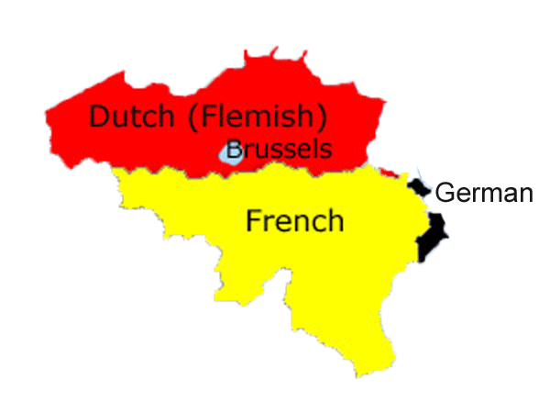
Official languages:
Dutch (60%)
French (39%)
German (1%)

Slide 6
Why so many languages?
Due to their close proximity to these three countries, we have three official languages that divide Belgium into three main regions.

Slide 7
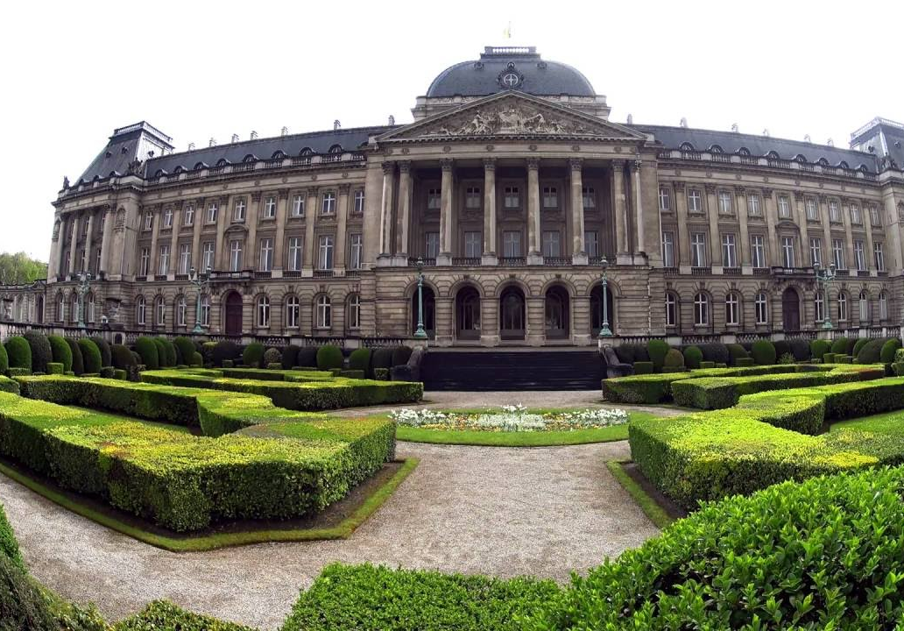
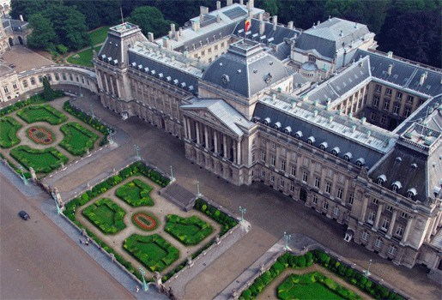
The royal Palace The Royal Palace was built on the site of the former Palace of the Dukes of Brabant which was destroyed by fire in 1731. Started in 1820 under the reign of King William, it was modified in 1904 under Leopold II, who had it rebuilt in Louis XVI style.

Slide 8
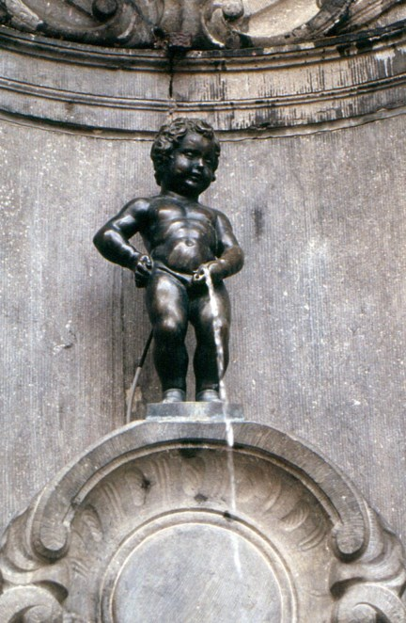
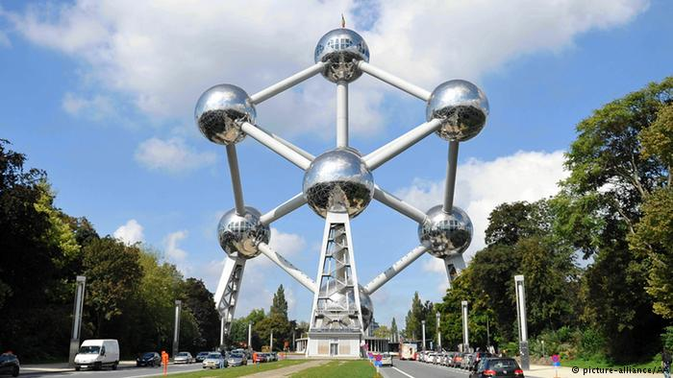
National monuments in Brussels
Manneke Pis
Atomium in Heizelpark

Slide 9
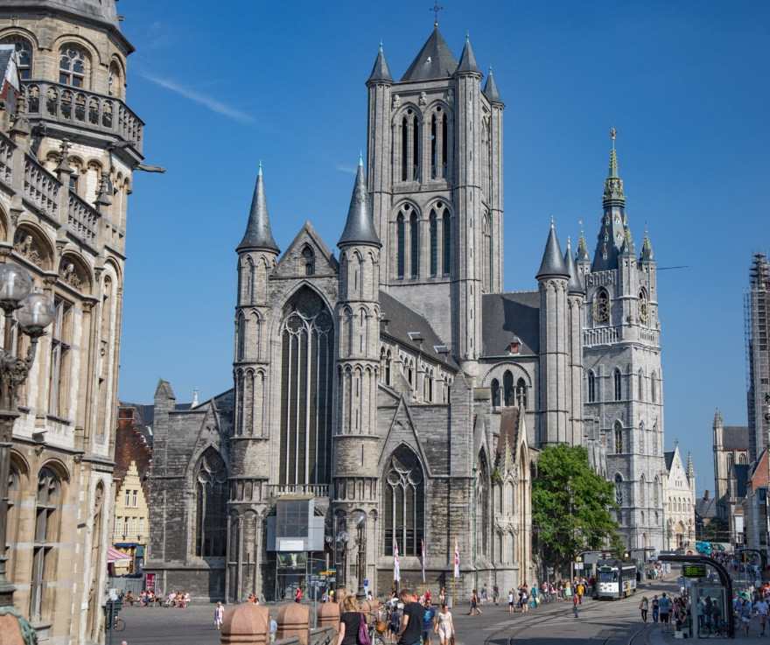
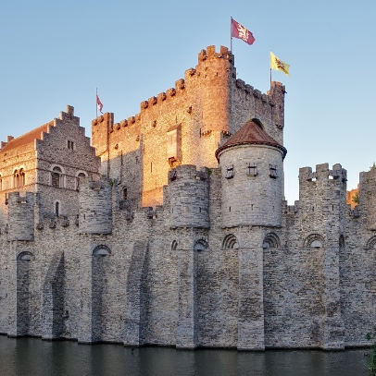
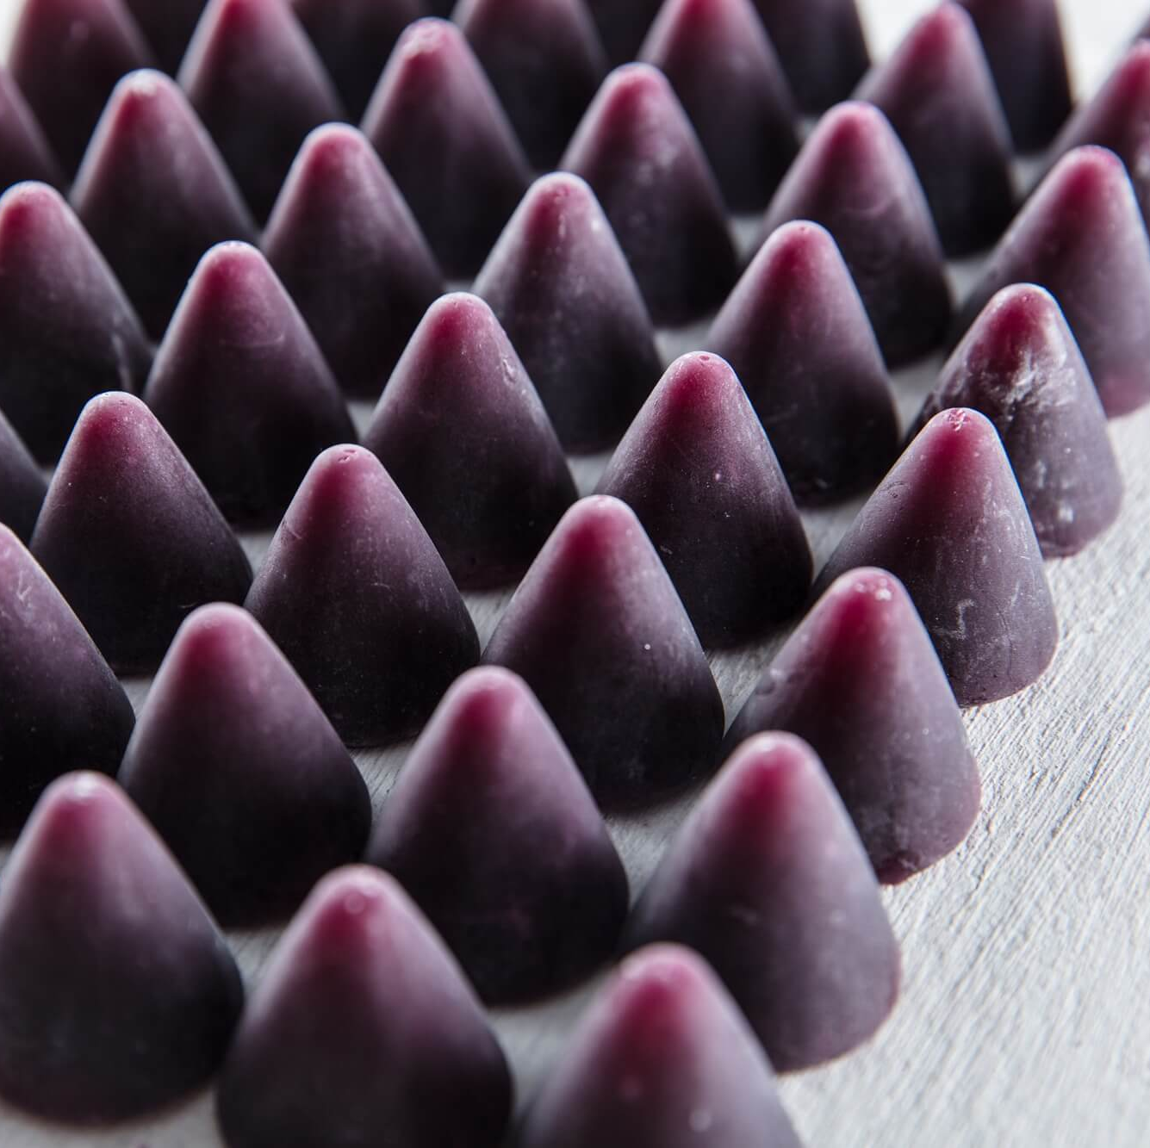
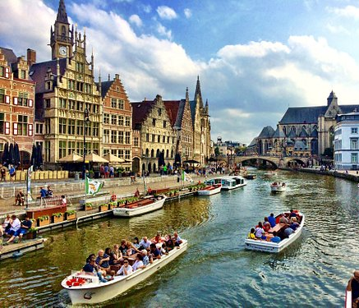
famous Flemish cities:
Ghent
Ghent is a city of history. During the Middle Ages, it was one of the richest and most powerful cities in Europe.

Slide 10
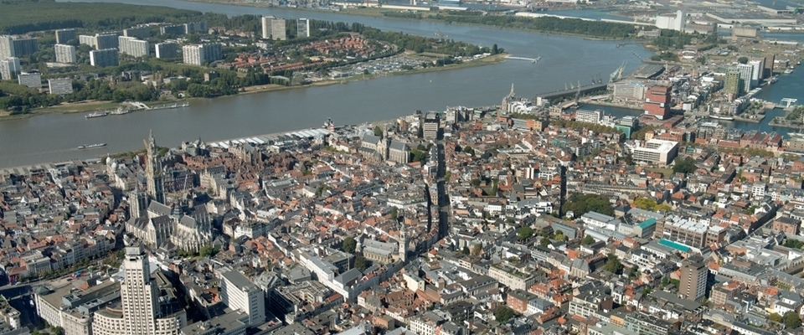
Antwerp Antwerp is the largest city in Belgium by area of 204,51 square kilometers and it’s the capital of Antwerp Province in the Flemish Region.

Slide 11
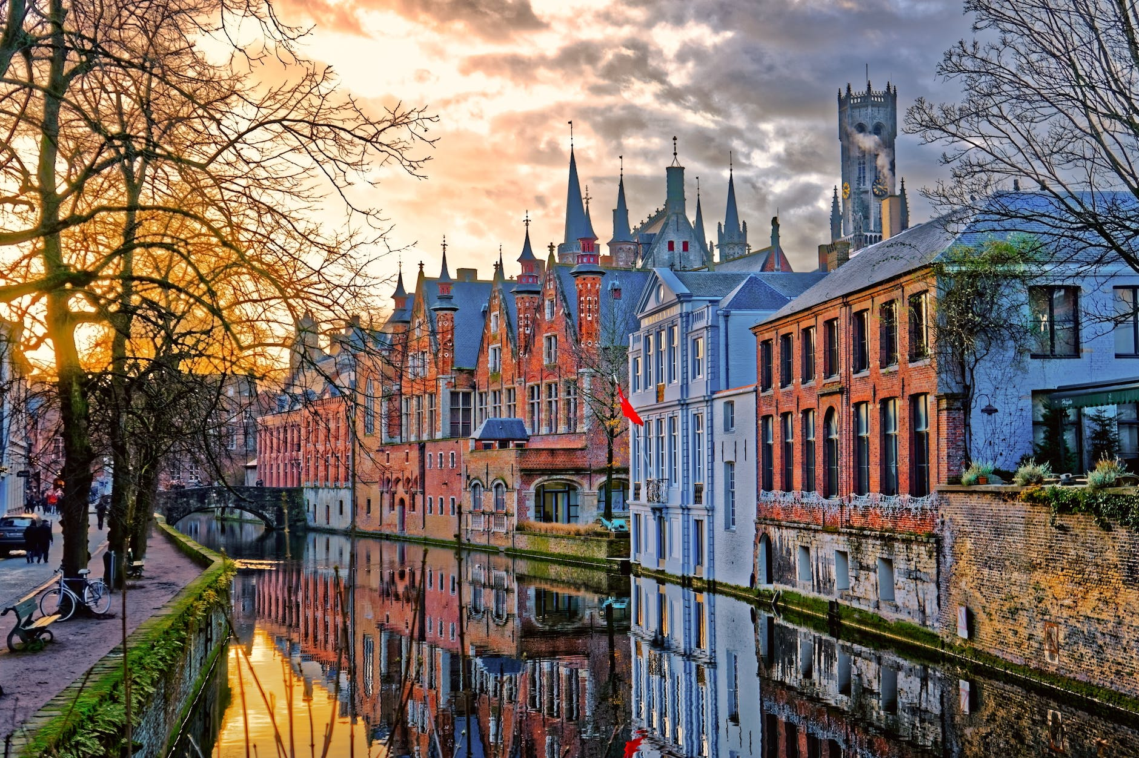
Bruges: Bruges is the capital and largest city of the province of West Flanders in the Flemish Region of Belgium.

Slide 12
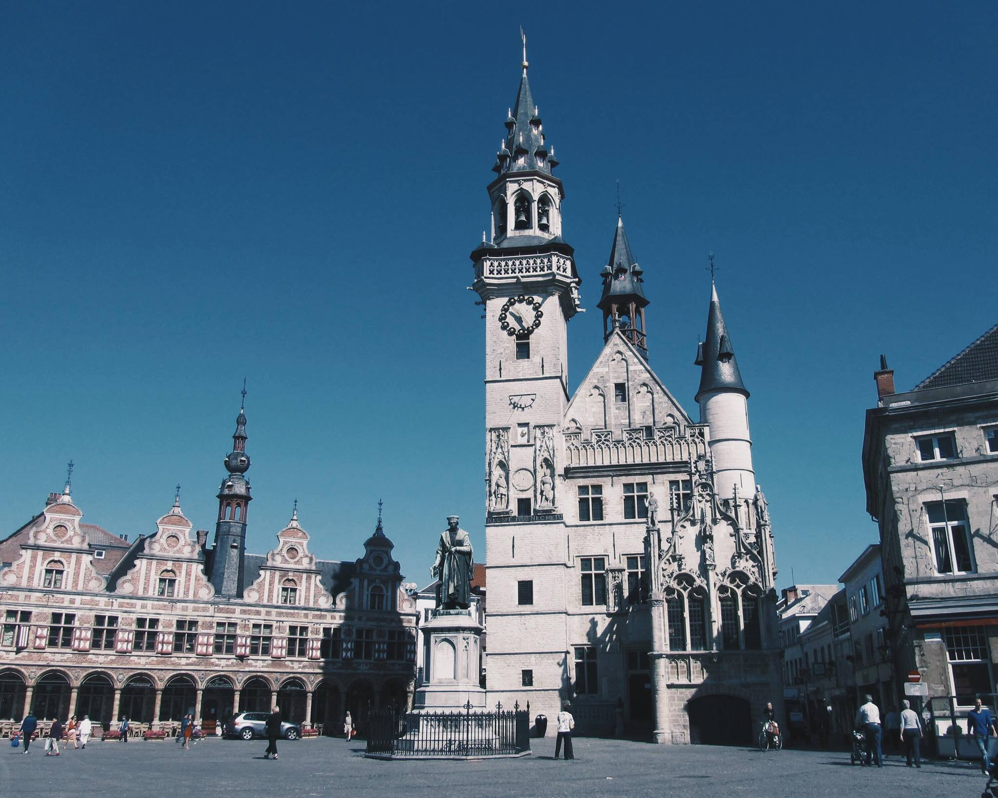
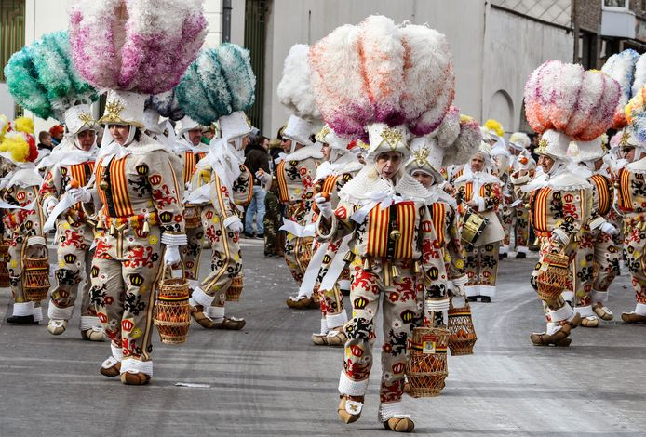
Aalst The town has a long standing (folkloric) feud with Dendermonde witch dates from the Middle Ages.

Slide 13
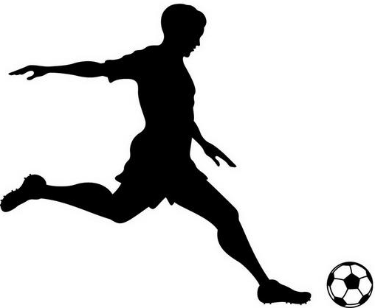
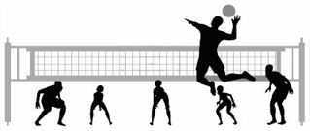
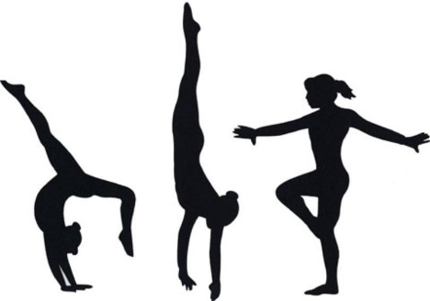
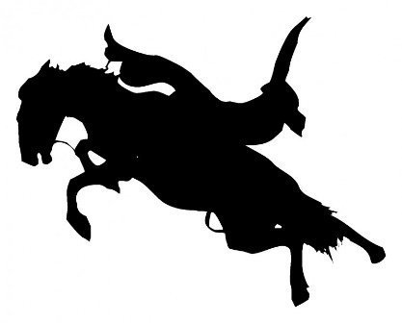
Popular sports

Slide 14
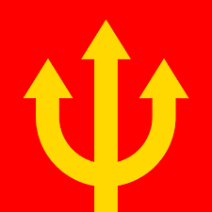
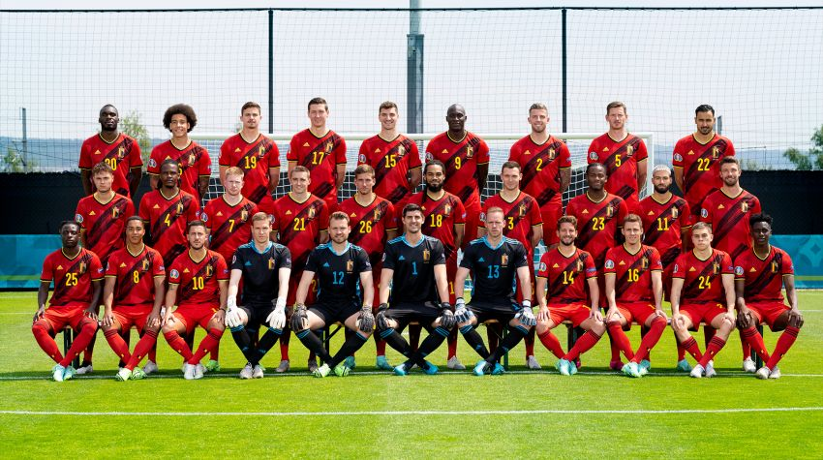
The national football team
Red Devils

Slide 15
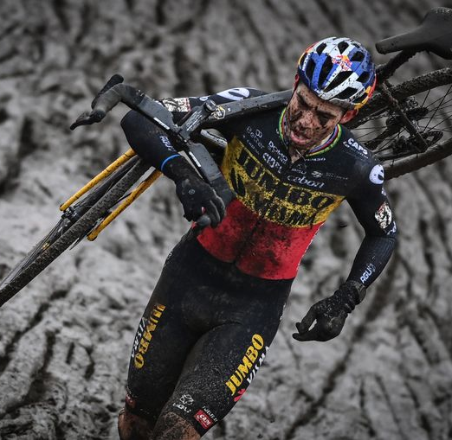
Cyclocross

Slide 16
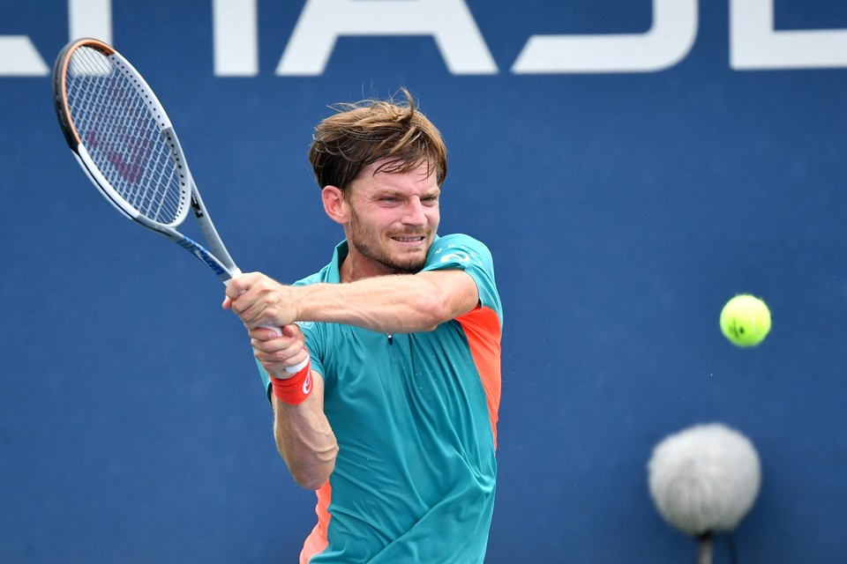
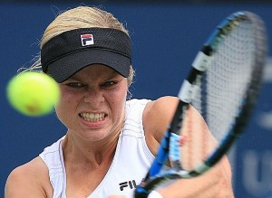
Tennis

Slide 17
Belgium is also very known for its…

Slide 18
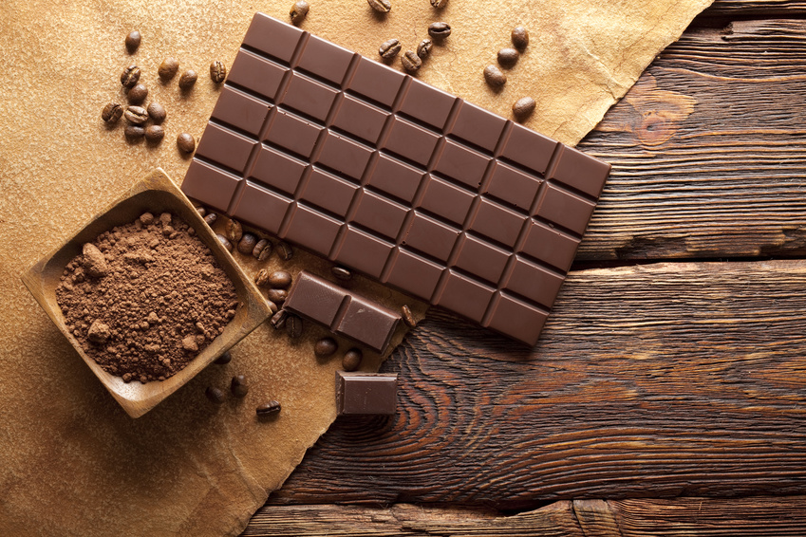
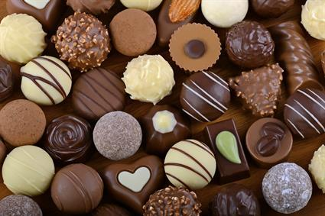
Chocolate

Slide 19
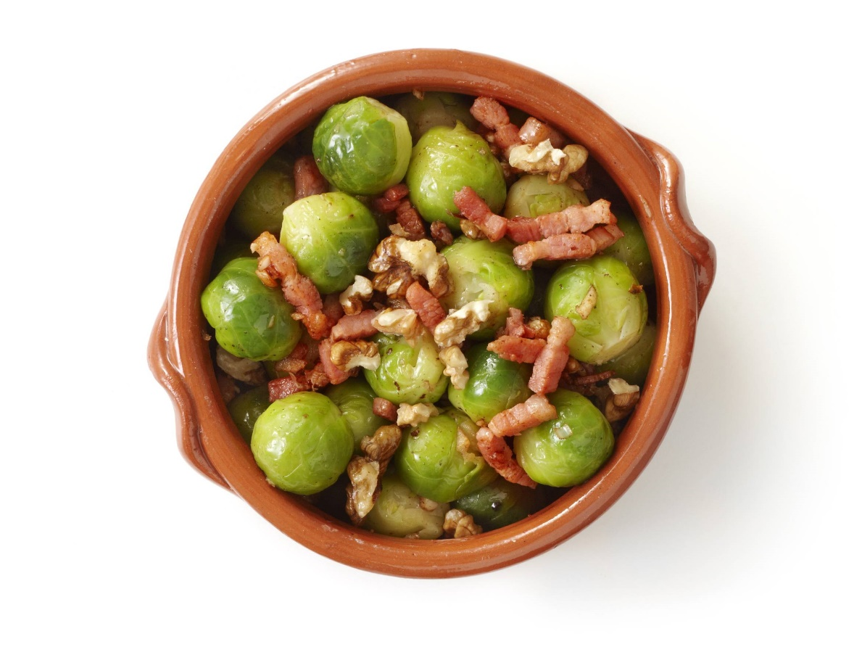
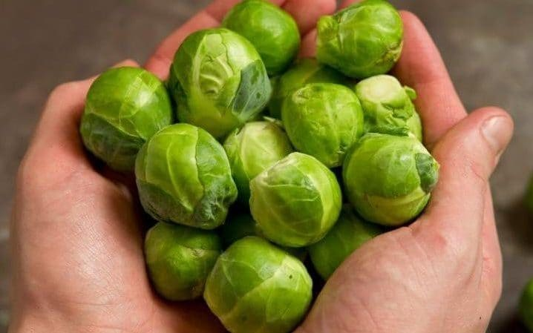
Brussels sprouts

Slide 20
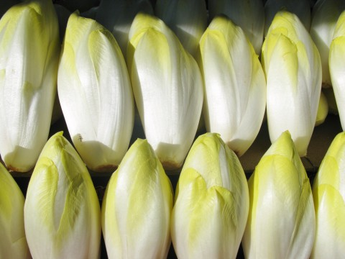
Chicory

Slide 21
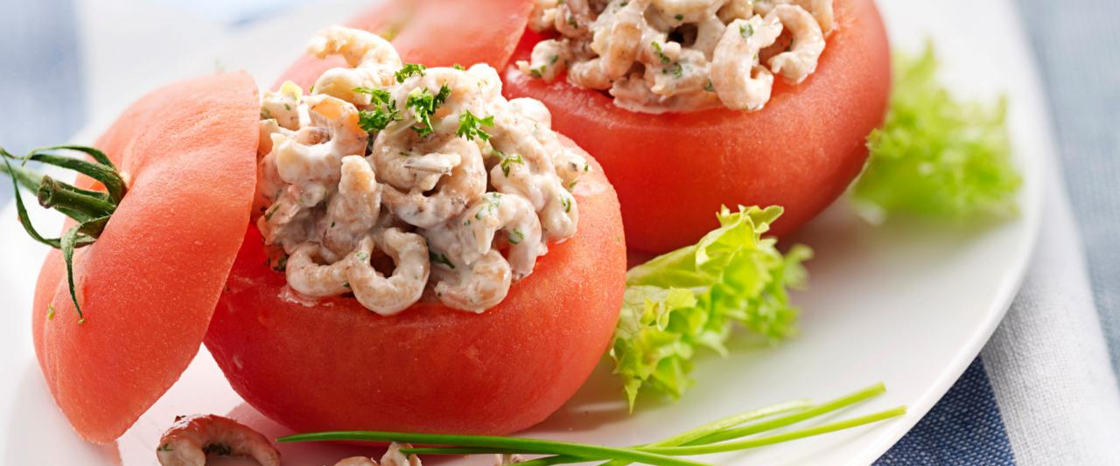
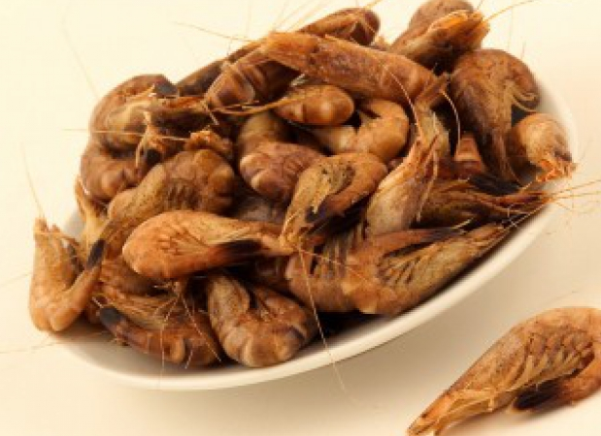
Northsea shrimps

Slide 22
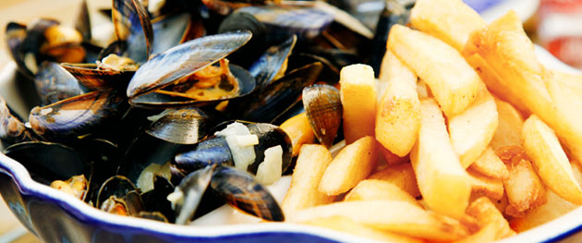
Mussels

Slide 23
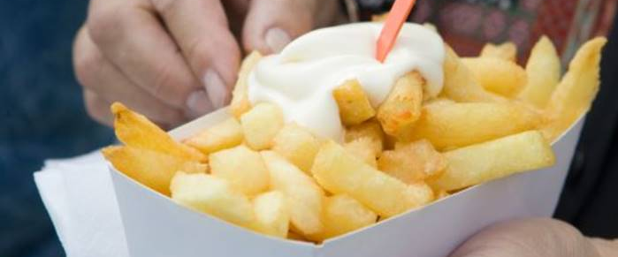
French Fries

Slide 24
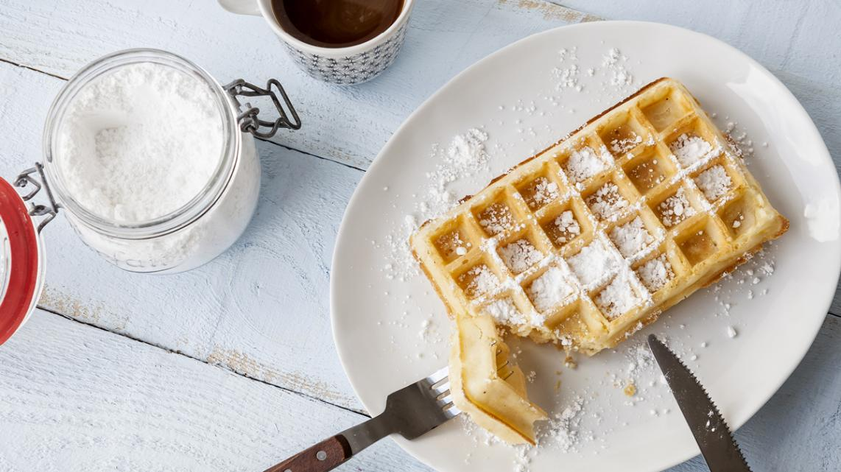
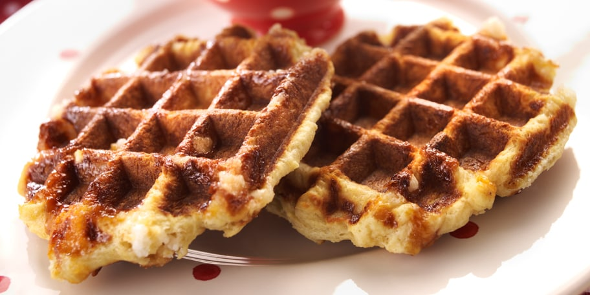
Waffles from
Brussels
Luik

Slide 25
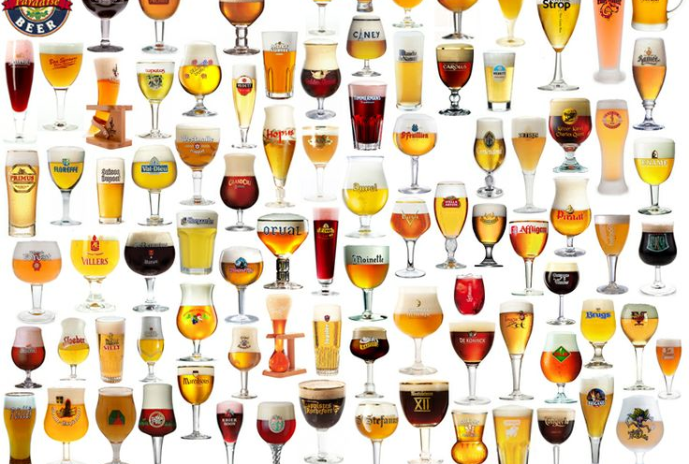
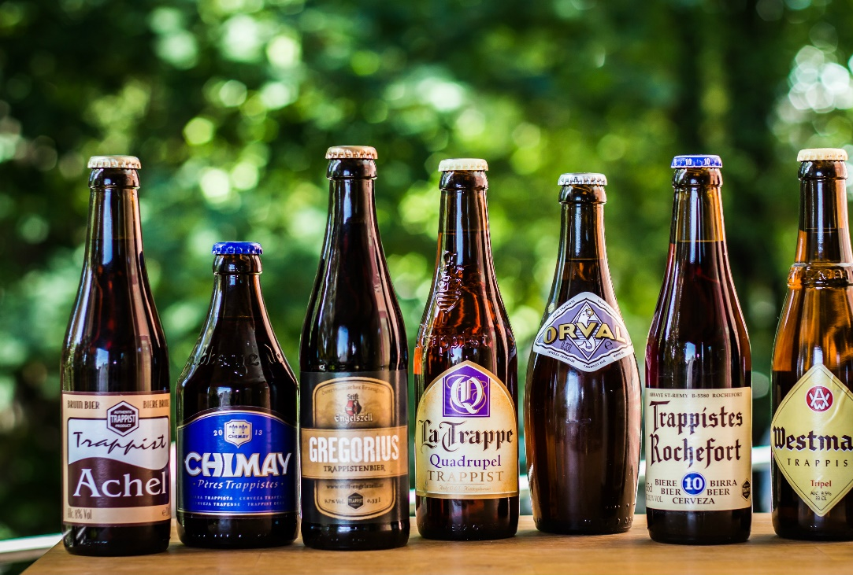
Beer
The country of beers
Over 1600 different beers
Brussels: a museum about beers

Slide 26
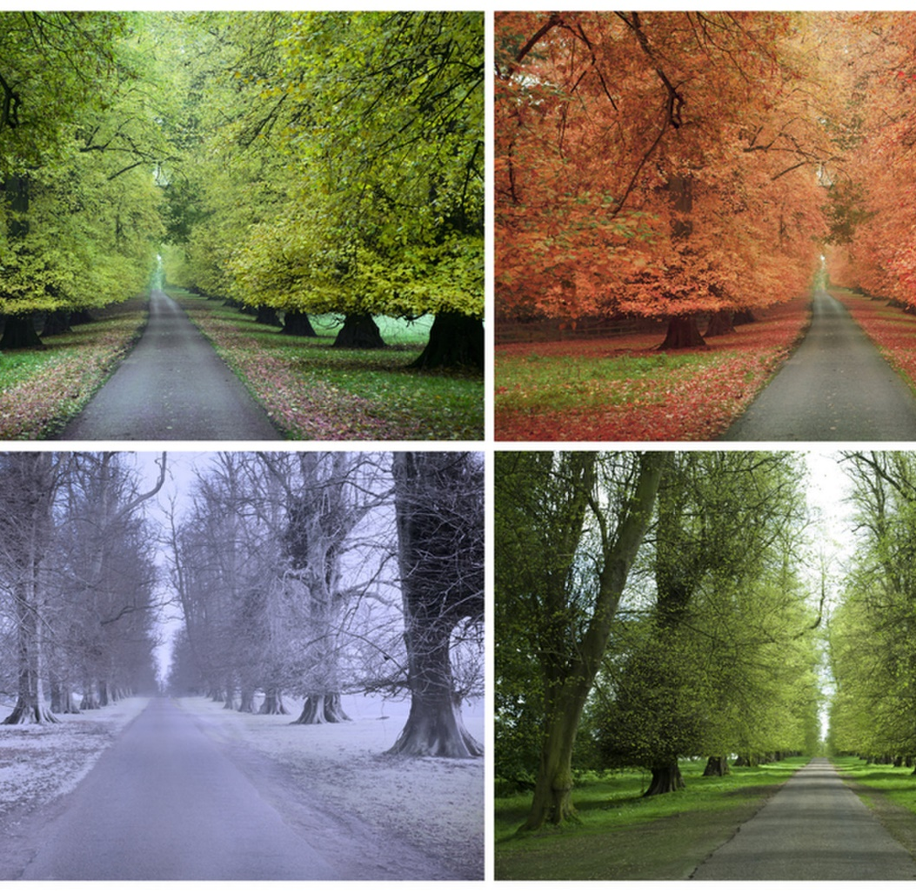
The weather in Belgium
4 Seasons

