Slide 1
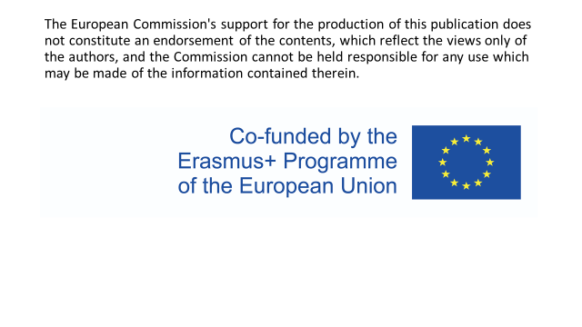

Slide 2
Czech Republic
Rules for administering medication - team Belgium

Slide 3
Who is responsible for the administration of medication? (oral, infusions, i.v. medication,…)
In Belgium, nurses are responsible for administering the prescription medication in hospitals. The nurse always needs a doctor’s order to administer medication.
Nurses receive a prescription of the doctor, stating the name of the patient, the name of the medication, dosage and how the medication should be administered, only then they can prepare and administer medication to a patient.
What kind of education do these people need?
In Belgium you can study nursing at 2 levels:
4 years of college
3 years HBO-5

Slide 4
How many people are necessary for the preparation and the administration of medication?
In hospitals, most of the medication is prepared by the night nurses and a double check will be done by the nurses with an early shift. For the preparation of most medicines there is no witness required.
The administration is the task of one nurse, she must indicate in the patient’s file which medication she administered and the time of administration.
When we speak about high risk medications a witness is required. High risk medication are medicines with an increased risk of causing serious harm to the patient if used incorrectly. This group of medicines includes anticoagulants, insulin, narcotic drugs and cytostatics for chemotherapy.

Slide 5
How do nurses record the administration of medication?
In Belgian hospitals, all nurses have their own personal badge with a staff number, name and medical department linked to it.
Before they administer medication they need to log in to the patient’s file to see what medication is required for the patient. The badge is automatically recognized by the computer system. In most hospitals in Belgium we use “KWS” or clinical work station.
After administration, the nurse must log in to the patient’s file to indicate all the medication that has been given to the patient. Her/his badge is automatically recognized by the computer and their name is signed like a signature.
There is no witness needed, everything is done automatically, so a stamp is no longer needed!

Slide 6
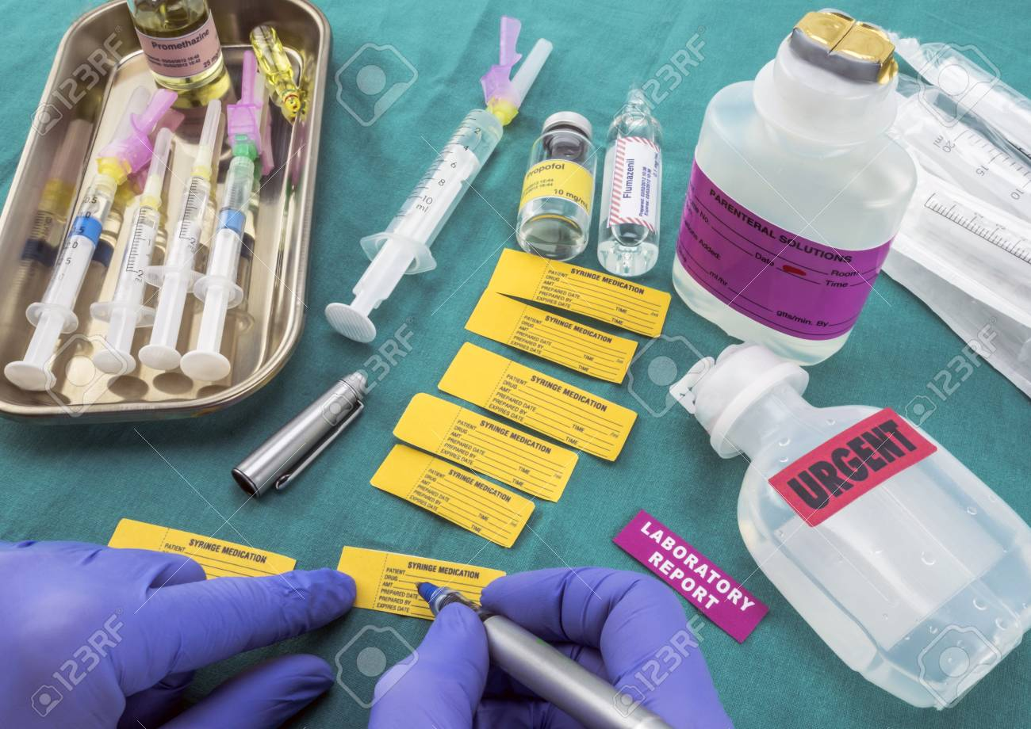
Can a night shift nurse prepare medication that is administered by a day shift nurse? Or is it necessary that these two duties are done by the same nurse?
In Belgian hospitals it’s common that the night nurse prepares some of the medication. They often prepare the oral medication for the entire day, they put these in small containers with the patient’s identity sticker on it and they stock these in the medication cart.
In the morning, when the other nurses start their early shift, they do a double check and administer the medication to the patients.
It’s very important that each type of medication is individually labeled with an identity sticker containing the following information:
the name of the patient, date of birth.
the name of het medication and the dosage
the time of administration

Slide 7
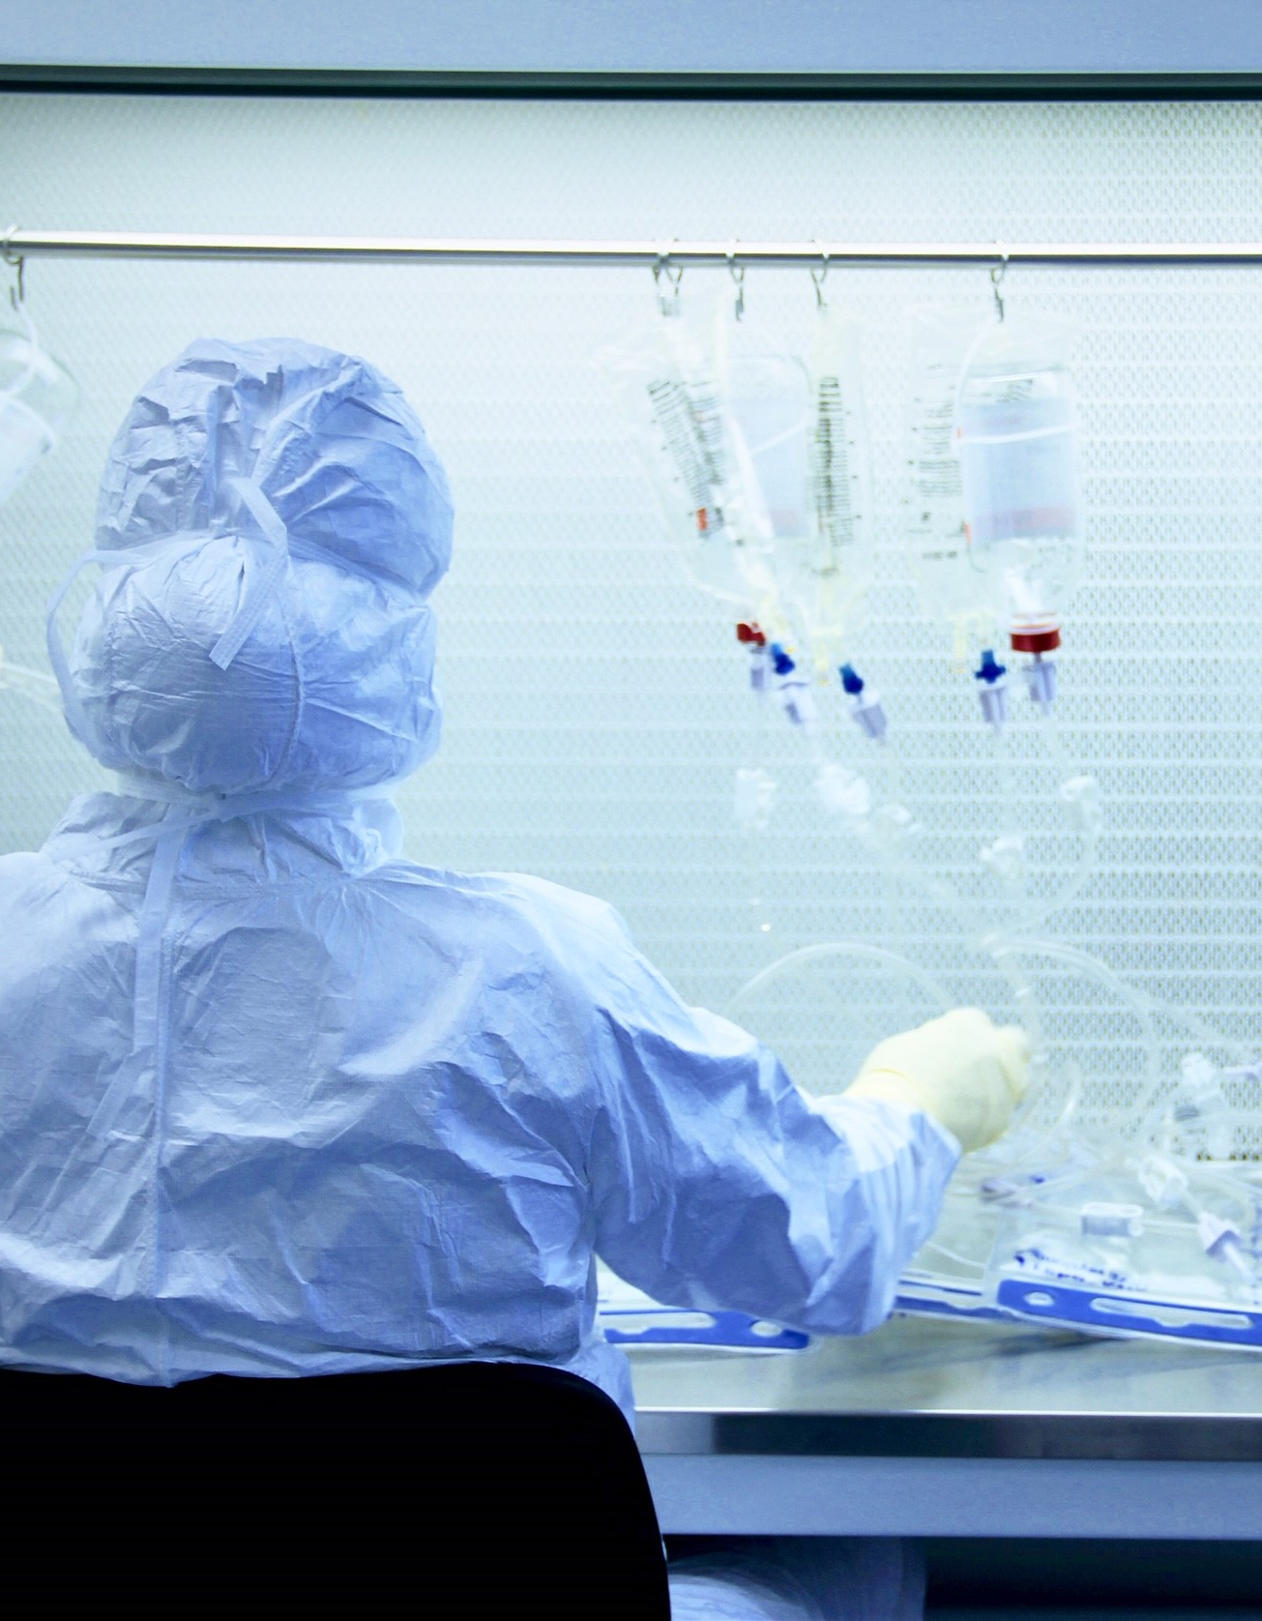
Can nurses administer patient’s own medication in hospital?
In the event of a planned hospital admission, the patient brings his own medication, that way it’s easy for the nurse to make a medication list of what the patient should take daily. They need to give the medication to the nurse on admission and the medication is kept at the nurse’s station.
All the medication that the patient receives comes from the pharmacy of the hospital. This is then indicated in the patient’s file and is charged by the hospital.

Slide 8
If the nurse cuts a tablet and administers only a half, can she return the other half to the original container?
No, manually halving medication is not a good alternative, this can not be done according to a reliable and validated method for most tablets and liquids.
Tablets with an entric coating should never be broken or crushed, the coating protects the medication from the acid environment or protects the stomach from the drug.
Also medication whose packaging has already been opened may no longer be administered to a patient for safety reasons as the packaging may contain other medication than indicated on the blister.

Slide 9
Can nurses prescribe any kind of medication?
Sinds January 1, 2012, nurse specialists and psychician assistants have a prescribing authority. This authority has been granted by the “Minister of Health Welfare”.
Only 3 types of specialized nurses are allowed to prescribe medication: pulmonary nurses, diabetes nurses and oncology nurses.
They may prescribe medication under the following conditions:
A diagnosis must have been made by a doctor, dentist or midwife.
They must adhere to medical standards and protocols regarding the prescription of drugs.
They prescribe within their area of expertise.

Slide 10
What are the rules while administering narcotics and storage of narcotics?
Narcotics and anesthetic medication is stored in the medical cabinet at the nurses station and can be opened by authorized personnel only, such as the head nurse.
Each time this medication is taken out of stock, it must be manually recorded and signed in a logbook:
Name of the nurse
Time and date of administration
Name of the medication and prescribed dosage
In some cases also the patient’s name
Everything must also be noted in the patient’s file.
The stock is checked several times so that no mistakes can happen and irregularities can ben noticed quickly.

Slide 11
What are common mistakes while administering medication and why do these slip-ups happen?
Medication given to the wrong patient
Wrong type of medication administered
Wrong dosage of medication administered
Wrong time of administration
Incorrect preparation of the medication. e.g: too much active ingredients.
RULE OF 5:
Right patient
Right medication
Right time of administration
Correct dosage
Correct method of administration

